Slide 1
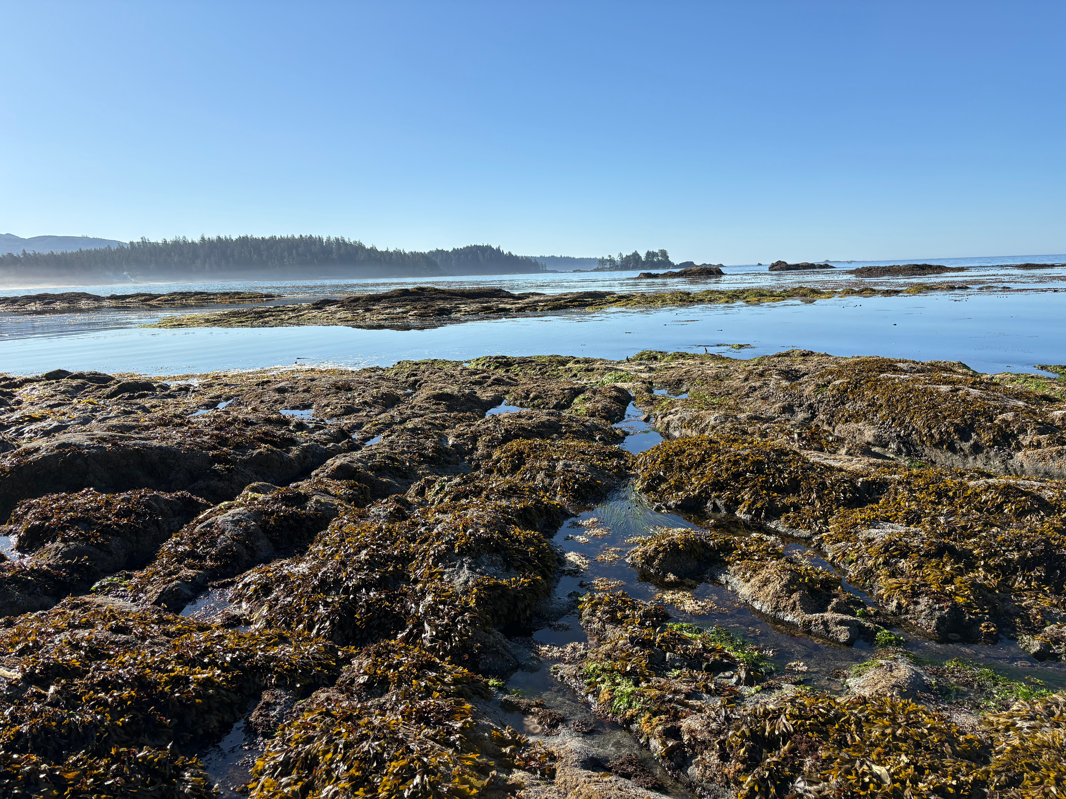



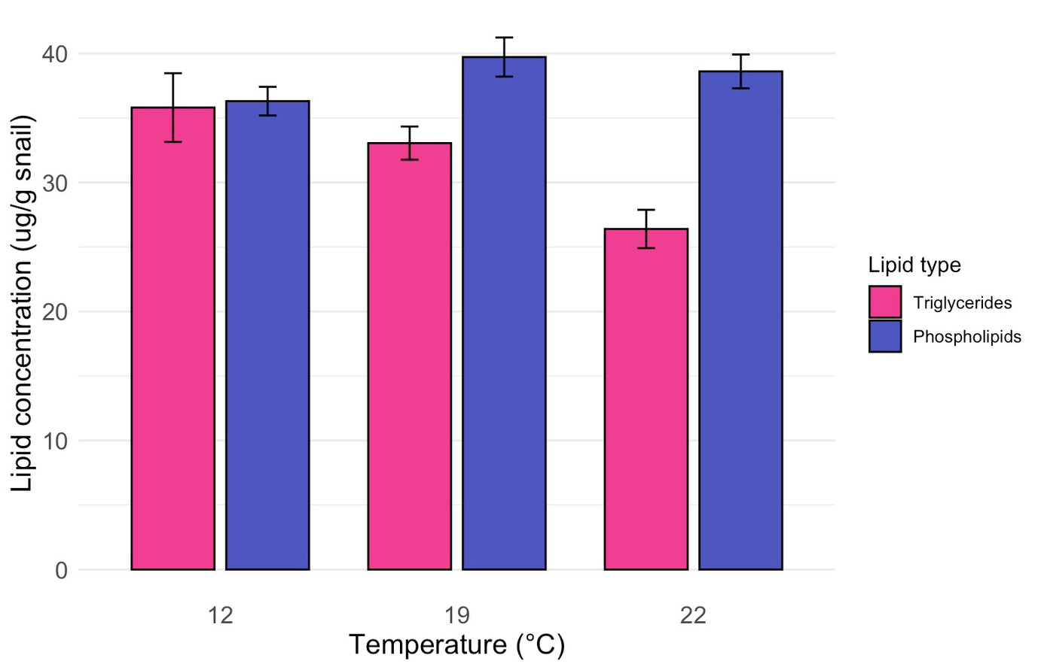
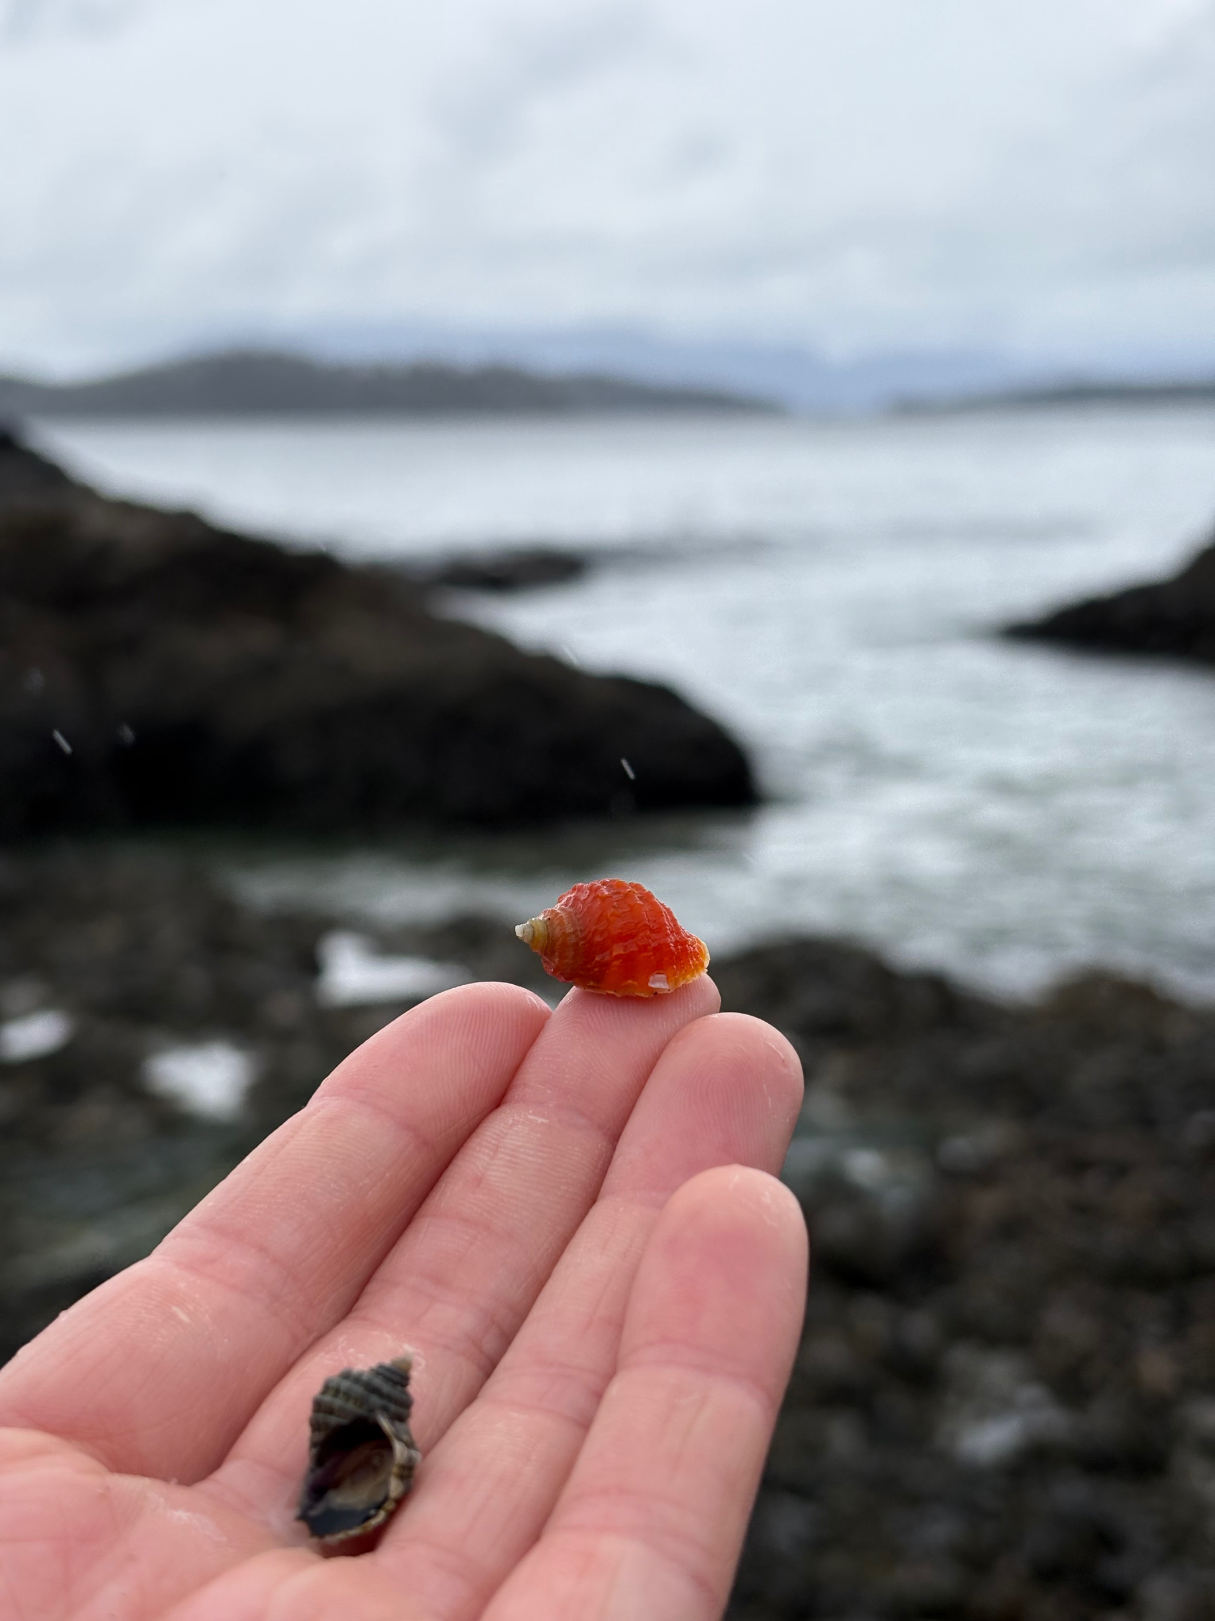
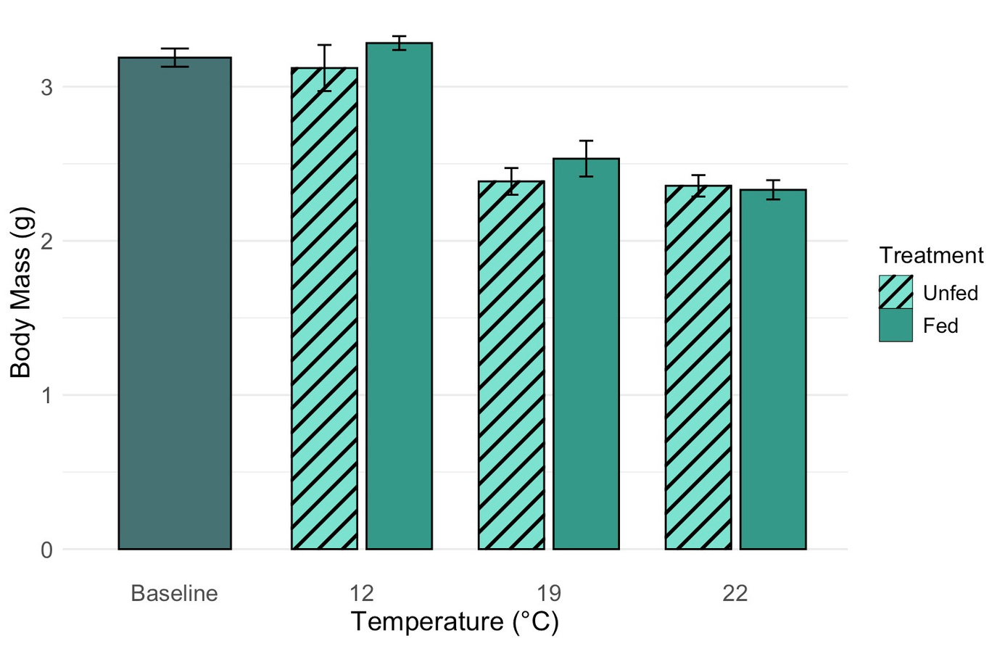
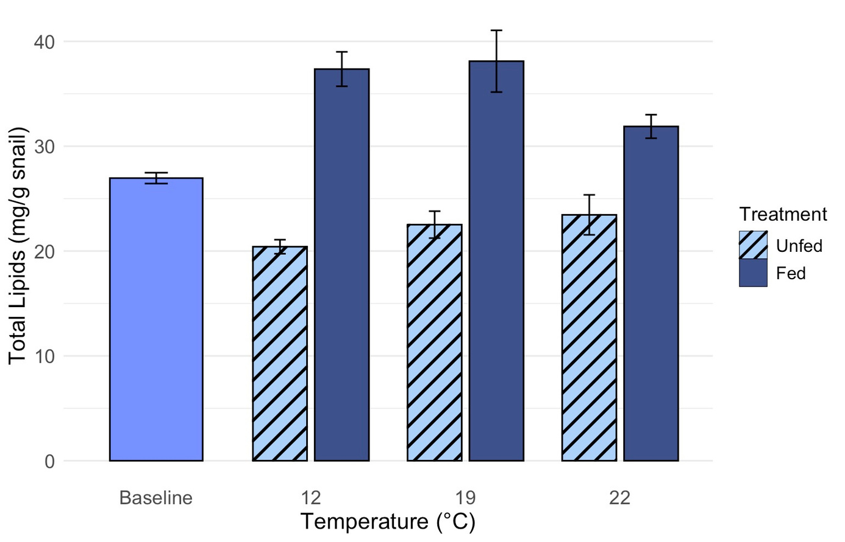
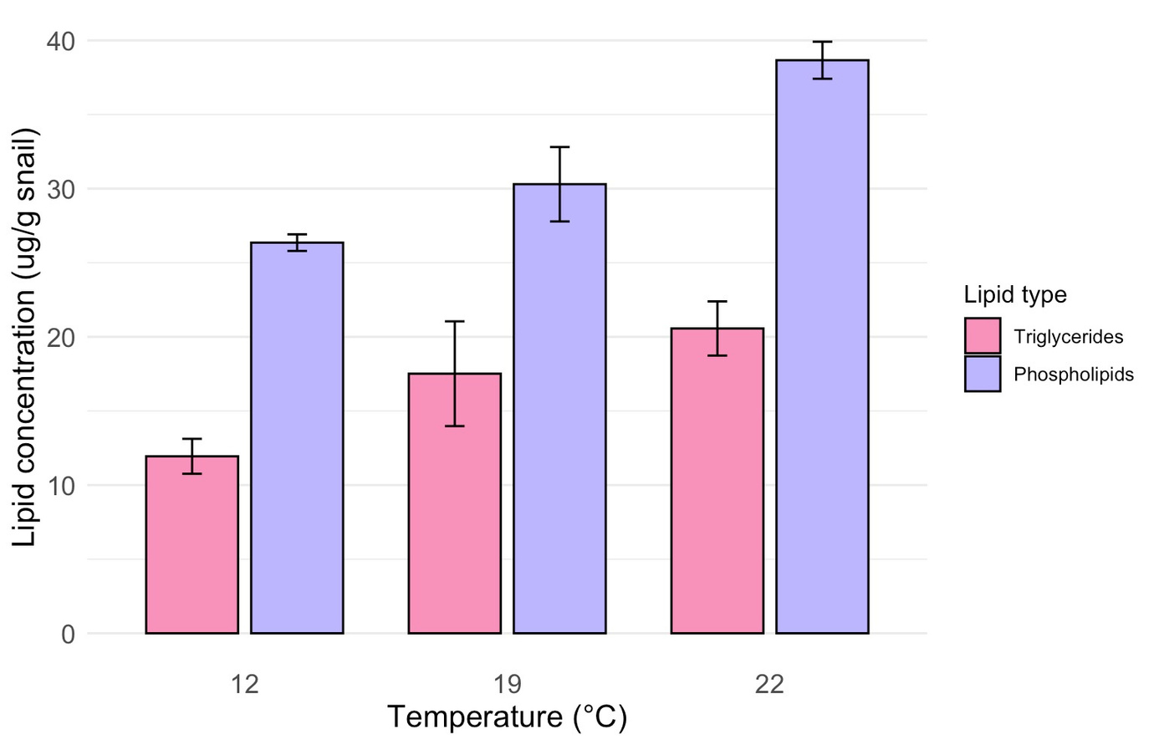
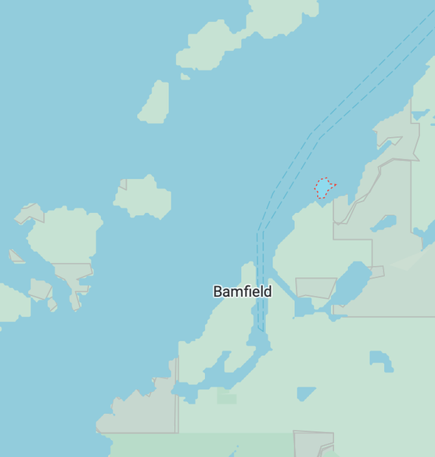
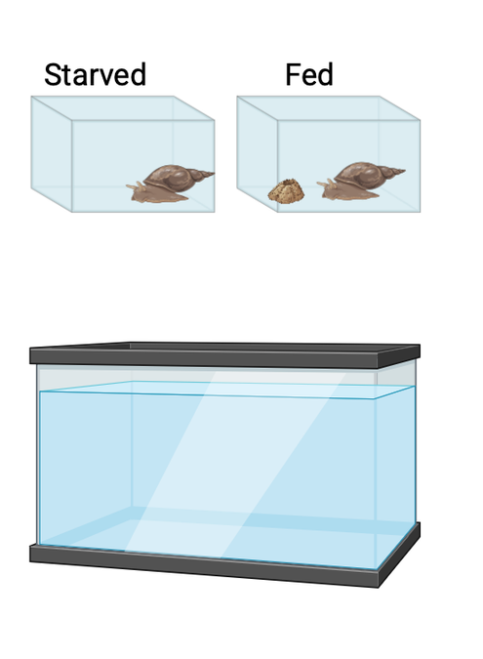

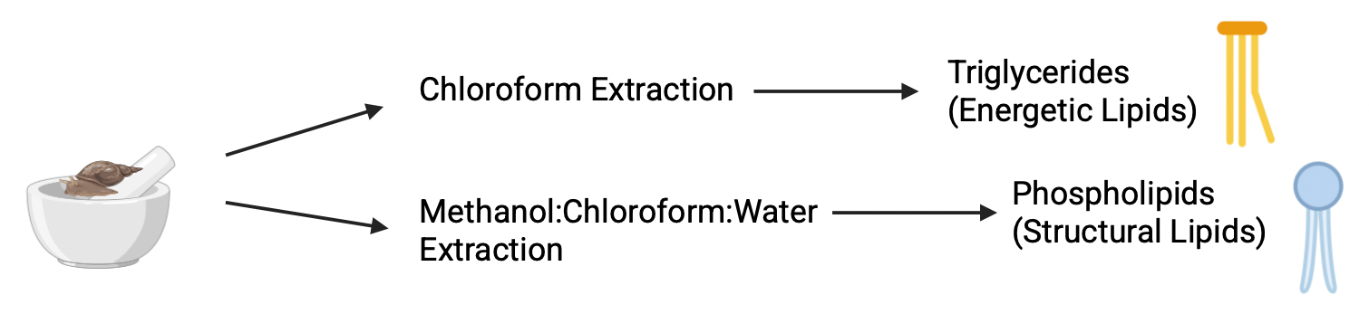
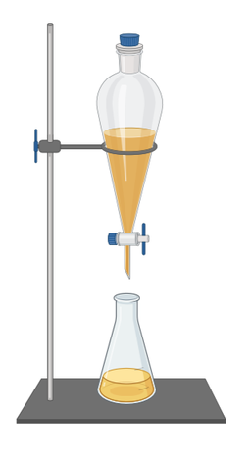

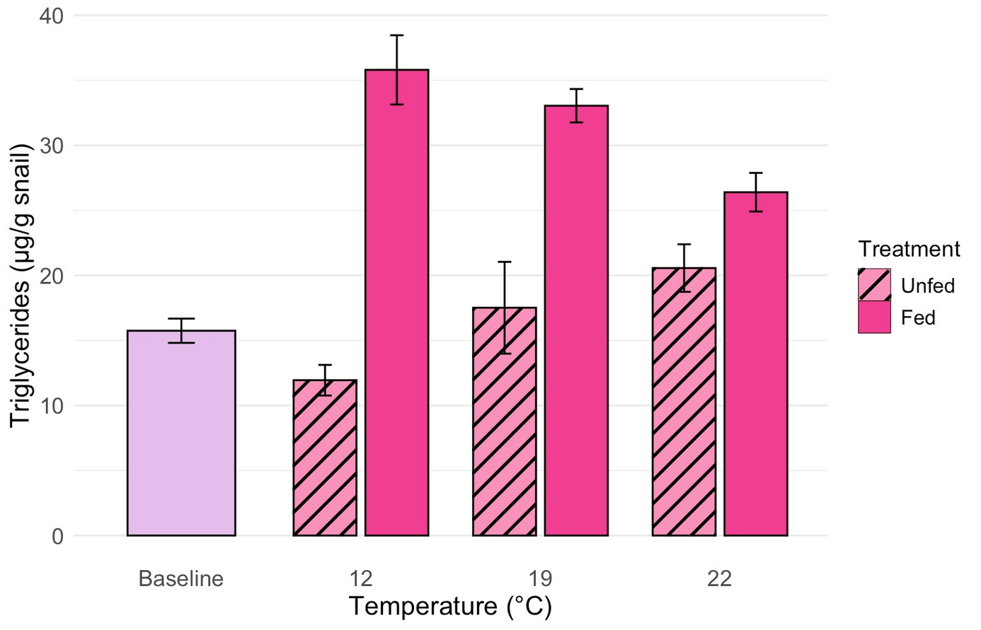
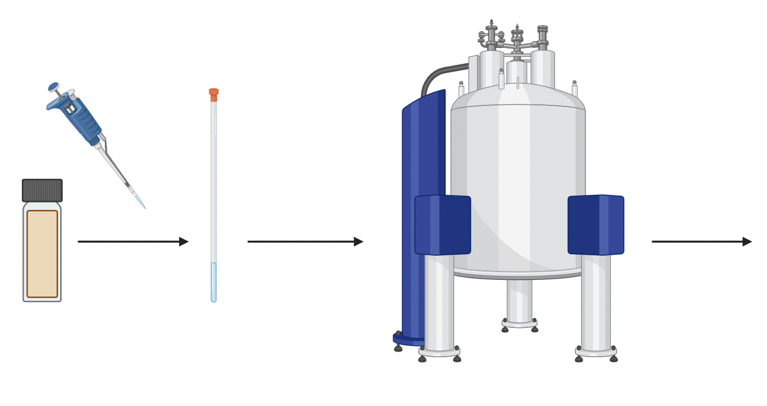


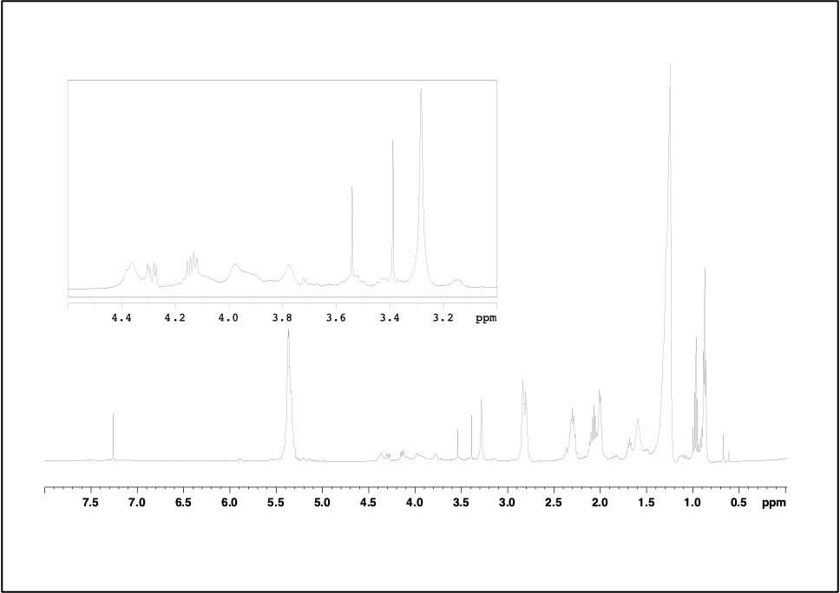
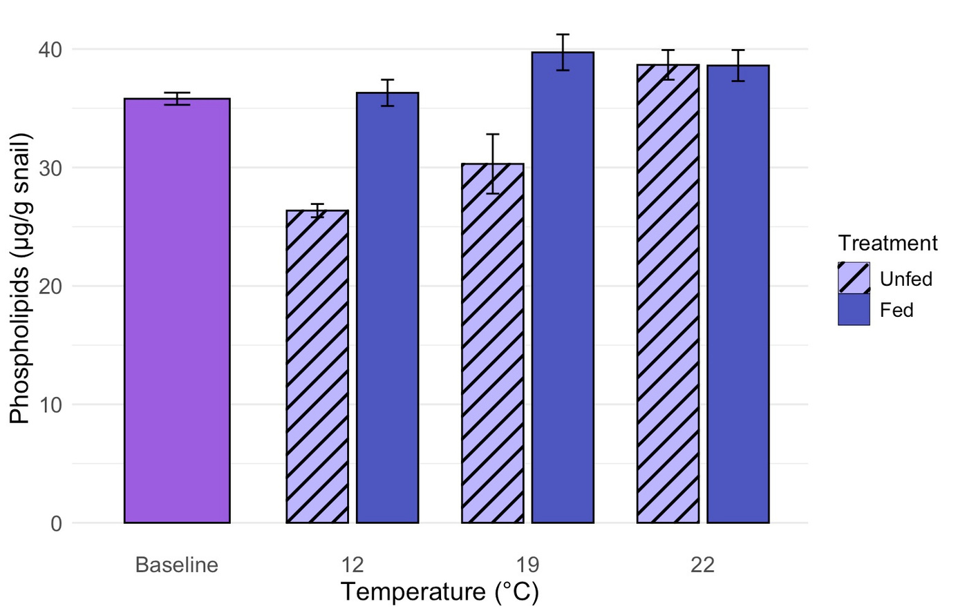
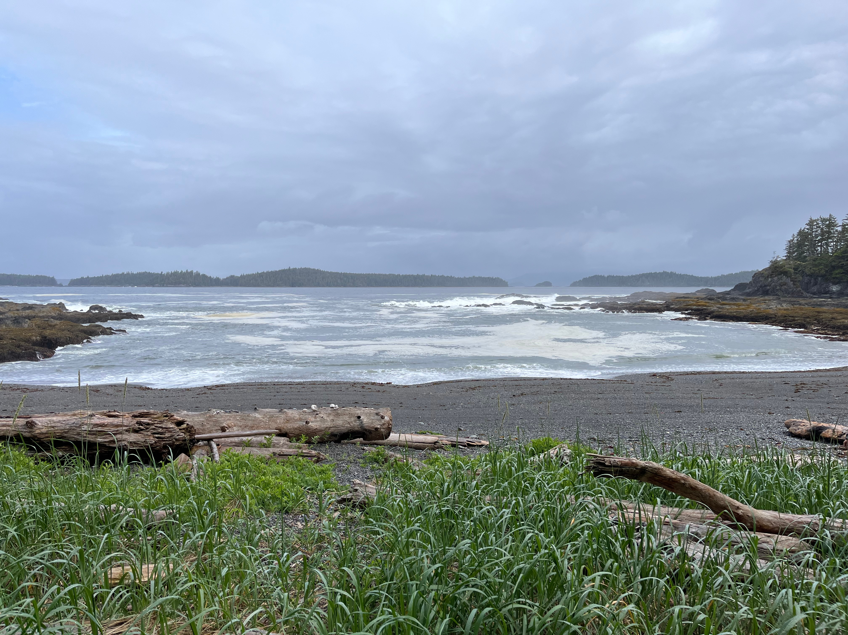


DETERMINATION OF TRIGLYCERIDE LEVELS IN NUCELLA OSTRINA USING QUANTITATIVE NMR SPECTROSCOPY
Tallis Dixon
Primary Supervisor: Dr. Louis Gosselin, Co-supervisor: Dr. Bruno Cinel
Department of Biological Sciences, Thompson Rivers University, Kamloops BC
INTRODUCTION
RESULTS
Survival often depends on the energy reserves the organism possesses; among the most important components of these energy reserves are lipids. Lipids are small, hydrophobic molecules that are both structurally diverse and functionally critical to biological systems (Imbs et al. 2021).
A key lipid class involved in energy storage is triglyceride (TG), TGs function as energy reservoirs, mobilized during times of high energetic demand such as starvation, metamorphosis, reproduction, or stress, and replenished under conditions of food abundance.
Body Mass
The two-way ANOVA results showed that with increasing temperature, body mass decreased significantly (F2,22 = 43.48, p = 0.001).
Post hoc Tukey comparisons indicated that TG levels at 22 °C and 19 ˚C were significantly lower than at 12 °C (p = 0.001), while no other pairwise comparisons were significant
Triglycerides & Phospholipids across Fed Treatment
Phospholipids show less variation across the temperatures as compared to the triglycerides.
As global climate conditions shift, the importance of understanding how energy is stored and used becomes even more critical. Sea surface temperatures are projected to increase by 2–4°C by the end of the 21st century (Valles-Regino et al. 2015), introducing new metabolic challenges for intertidal invertebrates.
Lipids are replenished through feeding Therefore, understanding how diet influences internal energy reserves is critical, as these reserves support not only the adult’s survival under environmental stress but also the provisioning of energy to offspring during early development.
RESEARCH QUESTIONS
Figure 6. Triglyceride and phospholipid concentrations (µg g⁻¹ snail) of fed adult Nucella ostrina across temperature treatments (12, 19, and 22 °C). Bars represent mean ± SE.
Determine how levels of energetic and structural lipids in adult snails are affected by exposure to elevated temperatures simulating future summertime seawater temperatures predicted for the west coast of Vancouver Island
The effects of food deprivation on energetic and structural lipid content
Figure 2. Mean body mass (g wet tissue) of adult Nucella ostrina across temperature (12, 19, and 22 °C) and feeding treatments (fed and unfed). Bars represent mean ± SE.
Triglycerides & Phospholipids across Un-Fed Treatment
Both phospholipids and triglycerides show variation across temperatures with increasing lipid concentration with increating temperature.
T
METHODS
Total Lipids
Individuals in fed treatments consistently exhibited higher total lipid concentrations than those in unfed treatments across all temperatures (F₁,23 = 70.8, p < 0.001).
ANIMAL COLLECTION
TEMPERATURE & STARVATION EXP’T
WIZARD ISLAND
DIXON ISLAND
Prasiola Point
Adults
BMSC
Increased temperatures
of 12, 19 & 22 ˚C
For 19 days
PRASIOLA POINT
LIPID EXTRACTION
Figure 7. Triglyceride and phospholipid concentrations (µg g⁻¹ snail) of unfed adult Nucella ostrina across temperature treatments (12, 19, and 22 °C). Bars represent mean ± SE.
Figure 2. Total lipid concentration (mg g⁻¹ snail) of adult Nucella ostrina across temperature (12, 19, and 22 °C) and feeding treatments (fed and unfed). Bars represent mean ± SE.
DISCUSSION
Triglycerides
A two-way ANOVA revealed a significant interaction between temperature and feeding treatments (F₂,₂₂ = 7.905, p = 0.003), indicating that the effect of feeding on triglyceride (TG) concentrations varied across temperature treatments.
Post hoc Tukey comparisons showed that TG levels at 22 °C were significantly higher than at 12 °C (p = 0.022), while no other pairwise comparisons were significant
Temperature and food availability are two primary environmental factors influencing energy balance in marine invertebrates, and their combined effects can determine whether stored energy is conserved or depleted. In this study, both factors contributed to variation in lipid reserves in adult Nucella ostrina, but their effects differed between energetic lipids (triglycerides, TG) and structural lipids (phospholipids, PL).
Food availability had the strongest and most consistent effect on lipid content. Individuals deprived of food exhibited reduced concentrations of total lipids, triglycerides, and phospholipids relative to fed individuals across all temperature treatments. This pattern aligns with established physiological expectations, where stored lipids, particularly triglycerides, are mobilized to meet metabolic demands during periods of starvation (Holland and Spencer 1973; Whyte et al. 1992).
Temperature effects were more variable and differed between lipid classes. In fed individuals, triglyceride concentrations declined with increasing temperature, suggesting that elevated metabolic demand under warmer conditions may increase lipid utilization even when food is available. In contrast, triglyceride concentrations in unfed individuals did not differ significantly across temperatures, indicating that lipid reserves were maintained at minimal levels necessary for survival.
Phospholipid concentrations remained relatively stable across temperatures in fed individuals, consistent with their primary role as structural components of cell membranes. In unfed individuals, phospholipid concentrations varied with temperature, with higher values observed at higher temperatures. This pattern suggests that prolonged combined stress from starvation and elevated temperature may stop the snails from moving around, maintaining their starting [PL], whereas in lower temperatures, the snails may be searching for food and moving around, potentially reflecting membrane remodelling or degradation under the stress conditions.
Overall, triglycerides and phospholipids exhibited distinct responses to temperature and food availability, reflecting their different biological functions. These findings indicate that energy reserves in N. ostrina are strongly influenced by food availability, while temperature effects are context-dependent and mediated by feeding status.
SINGLE - STEP
CHLOROFORM
EXTRACTION
BLIGH & DYER
EXTRACTION
NMR
Lipid Extracts
Figure 4. Triglyceride concentration (µg g⁻¹ snail) of adult Nucella ostrina across temperature (12, 19, and 22 °C) and feeding treatments (fed and unfed). Bars represent mean ± SE.
Phospholipids
A two-way ANOVA showed a significant interaction between temperature and feeding treatments (F₂,₂₁ = 6.286, p = 0.007), showing the effect of feeding on PL concentrations varied across temperature treatments
Post hoc Tukey comparisons for the unfed treatment indicated that PL concentrations at 22 °C were significantly lower than at 12 °C (p = 0.030), while no other pairwise comparisons were significant
DME
PL
TG
CDCl3
REFERENCES
Bligh EG, Dyer WJ. 1959. A RAPID METHOD OF TOTAL LIPID EXTRACTION AND PURIFICATION. Can J Biochem Physiol. 37(8):911–917. doi: https://doi.org/10.1139/o59-099
Dipesh Prema, Pilfold JL, Krauchi J, Church JS, Donkor KK, Cinel B. 2013. Rapid Determination of Total Conjugated Linoleic Acid Content in Select Canadian Cheeses by1H NMR Spectroscopy. Journal of Agricultural and Food Chemistry. 61(41):9915–9921. doi: https:// dx.doi.org/10.1021/jf402627q
Holland DL, Spencer BE. 1973. Biochemical Changes in Fed and Starved Oysters, Ostrea Edulis L. During Larval Development, Metamorphosis and Early Spat Growth. J Mar Biol Assoc U K. 53(2):287–298. doi: https://doi.org/10.1017/S002531540002227X
Imbs AB, Ermolenko EV, Grigorchuk VP, Sikorskaya TV, Velansky PV. 2021. Current Progress in Lipidomics of Marine Invertebrates. Mar Drugs. 19(12):660. doi: https://doi.org/10.3390/md19120660
Valles-Regino R, Tate R, Kelaher B, Savins D, Dowell A, Benkendorff K. 2015. Ocean Warming and CO2-Induced Acidification Impact the Lipid Content of a Marine Predatory Gastropod. Mar Drugs. 13(10):6019–6037. doi: https://doi.org/10.3390/md13106019
Whyte JNC, Bourne N, Ginther NG, Hodgson CA. 1992. Compositional changes in the larva to juvenile development of the scallop Crassadoma gigantea (Gray). J Exp Mar Biol Ecol. 163(1):13–29. doi: https://doi.org/10.1016/0022-0981(92)90144-Y
Figure 3. 600 MHz 1H -NMR spectra of lipid extracts from the adult snail N. ostrina. The peaks are labelled as follows: CDCl3, deuterated chloroform; TG, triglyceride; DME, 1, 2-dimethoxyethane; PL, phosphatidylcholine and lysophosphatidylcholine.
Contact:
Tallis Dixon
tallisdixon@gmail.com
Figure 5. Phospholipid concentration (µg g⁻¹ snail) of adult Nucella ostrina across temperature (12, 19, and 22 °C) and feeding treatments (fed and unfed). Bars represent mean ± SE.

