Slide 1

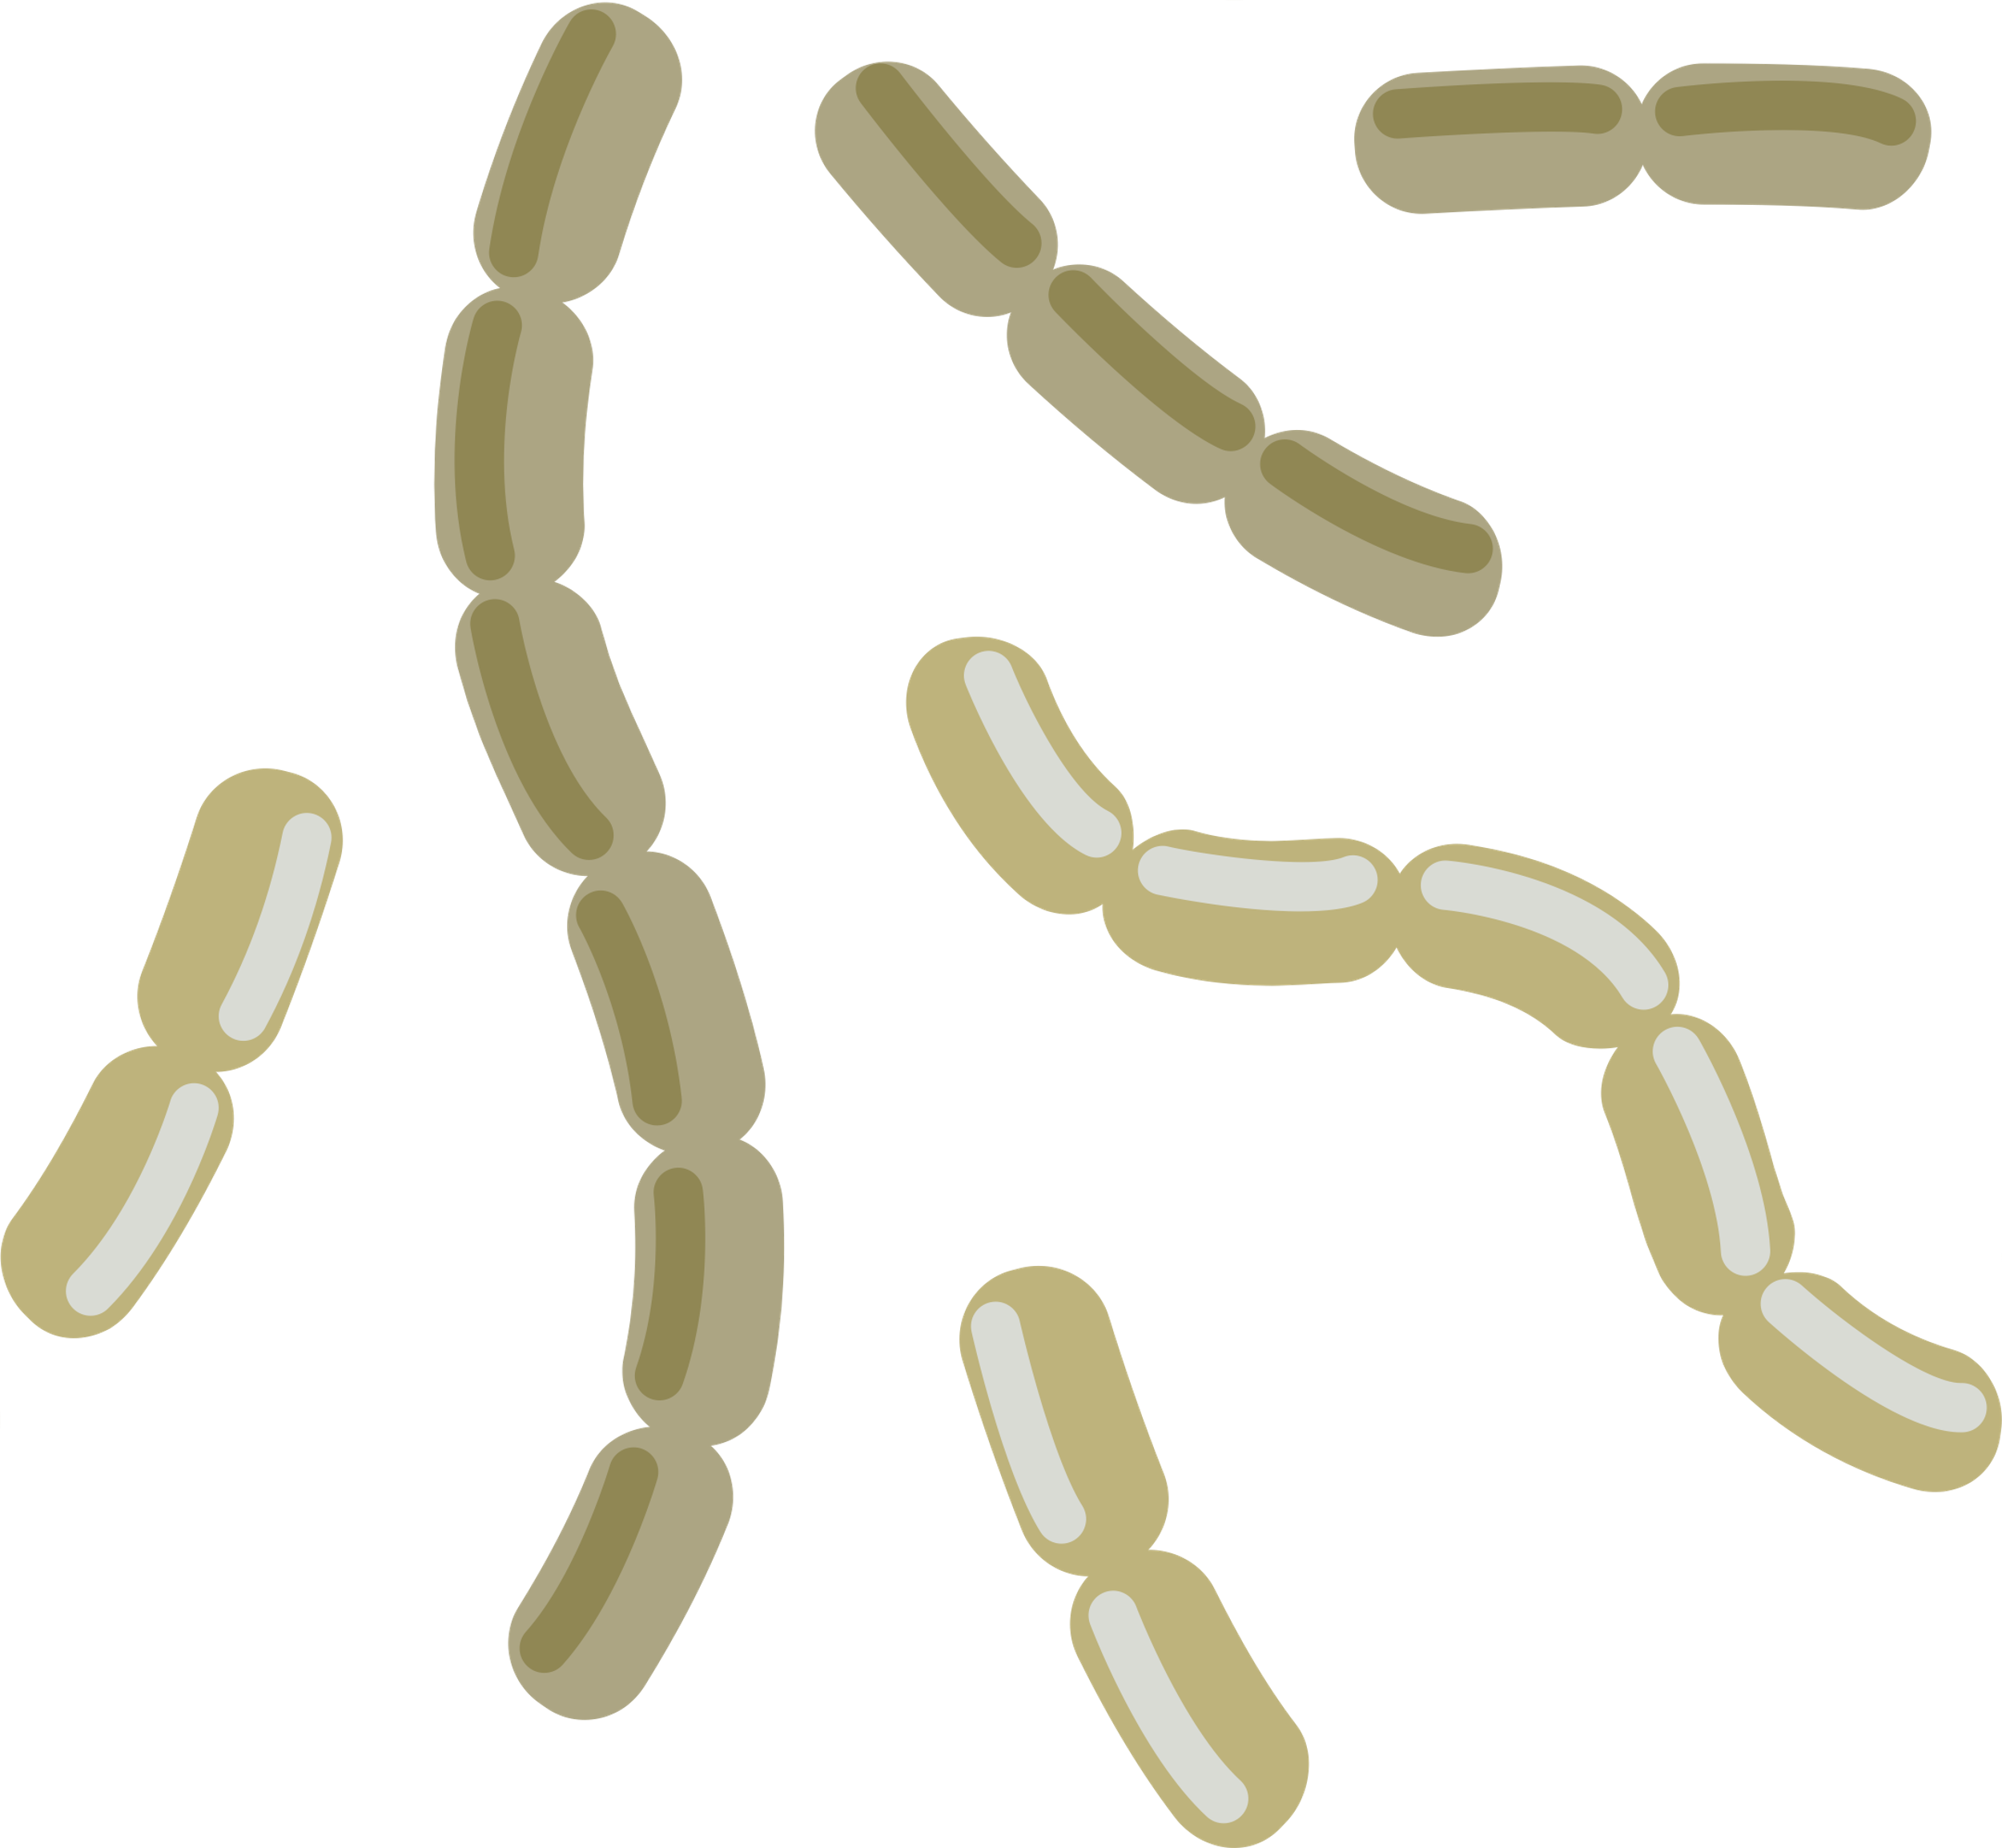
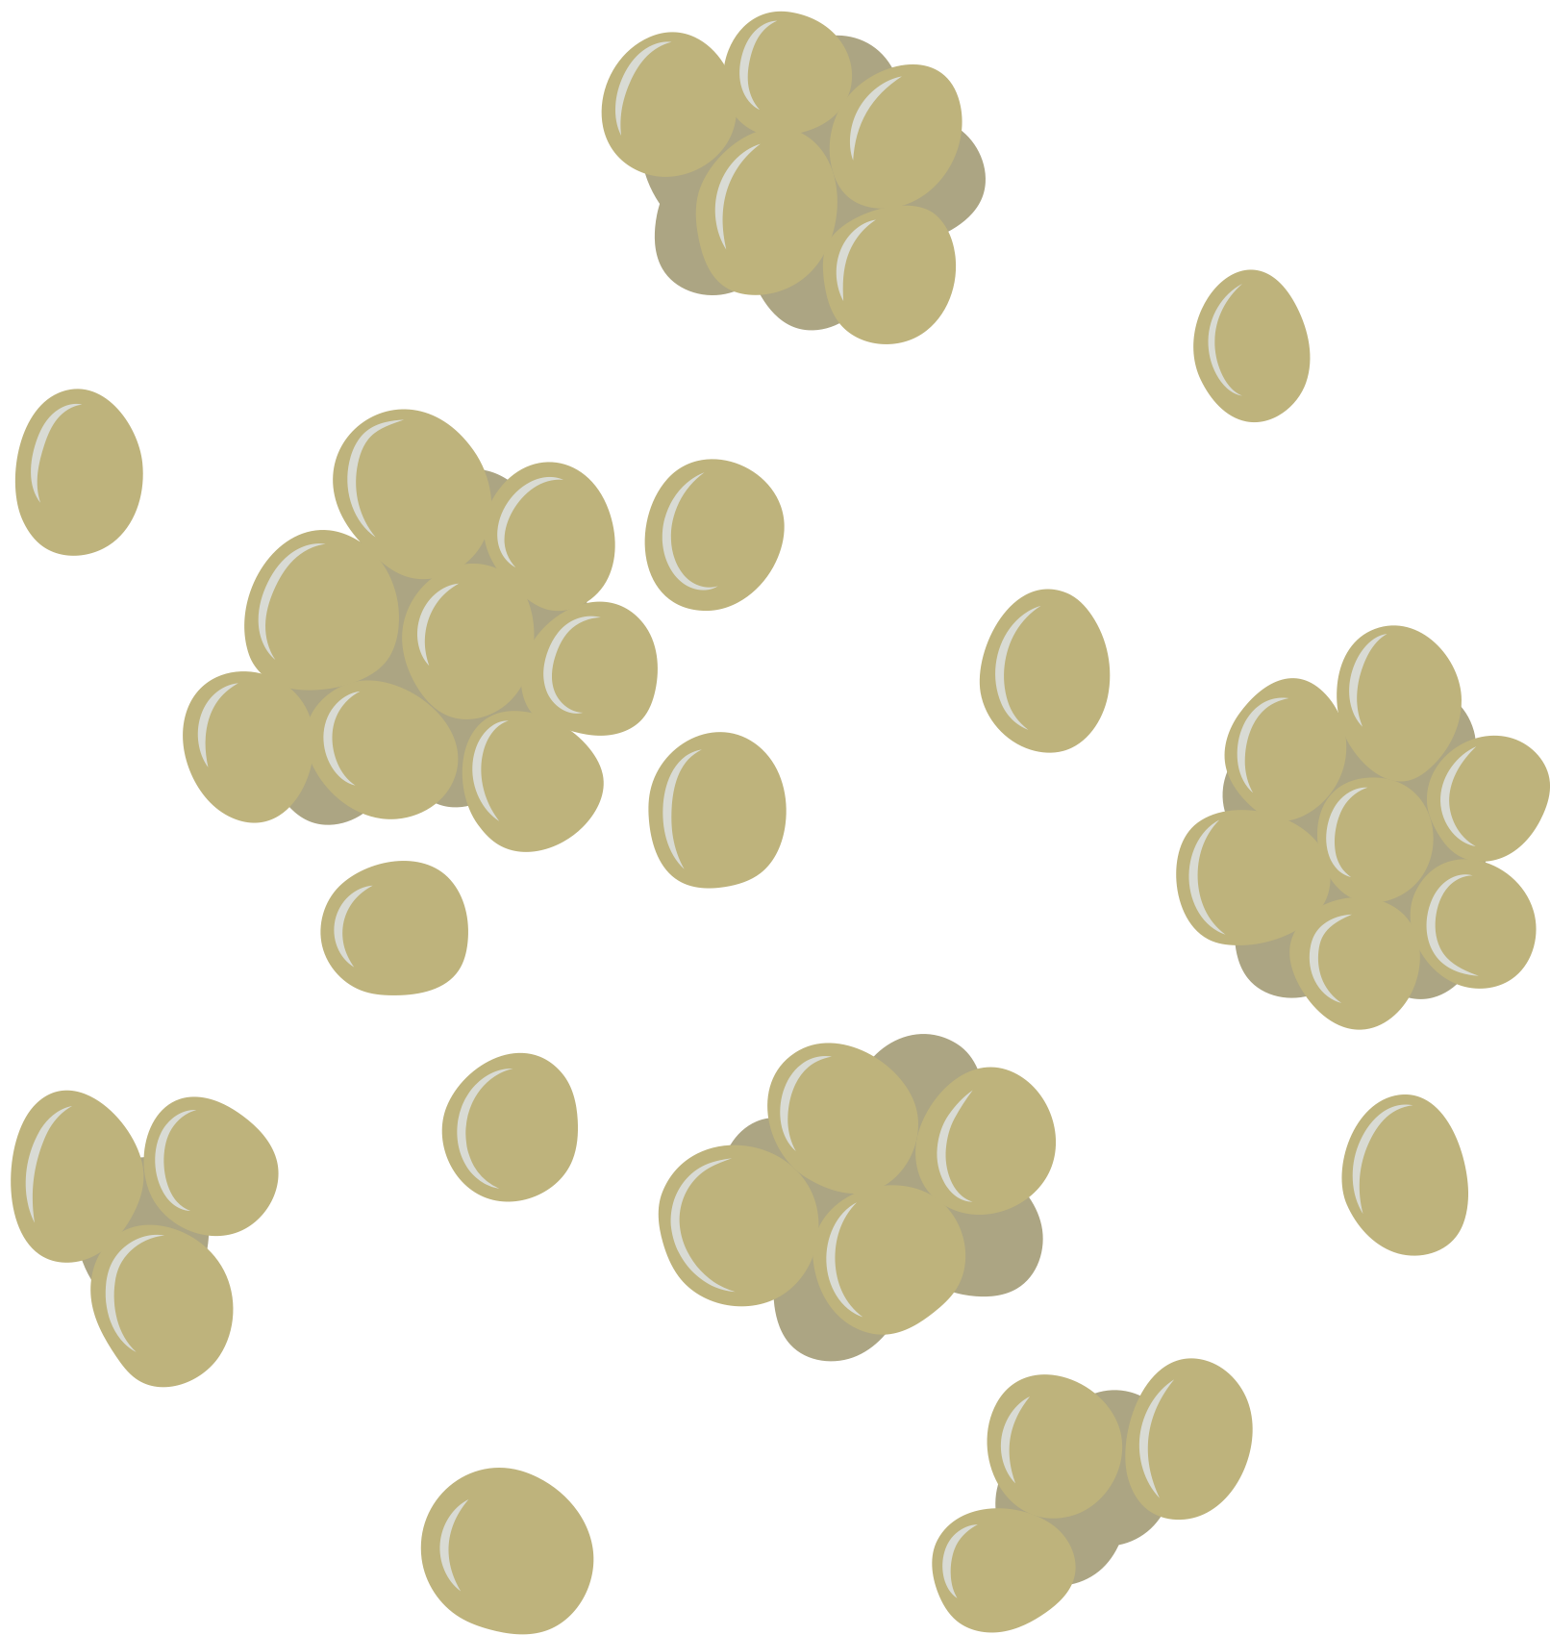
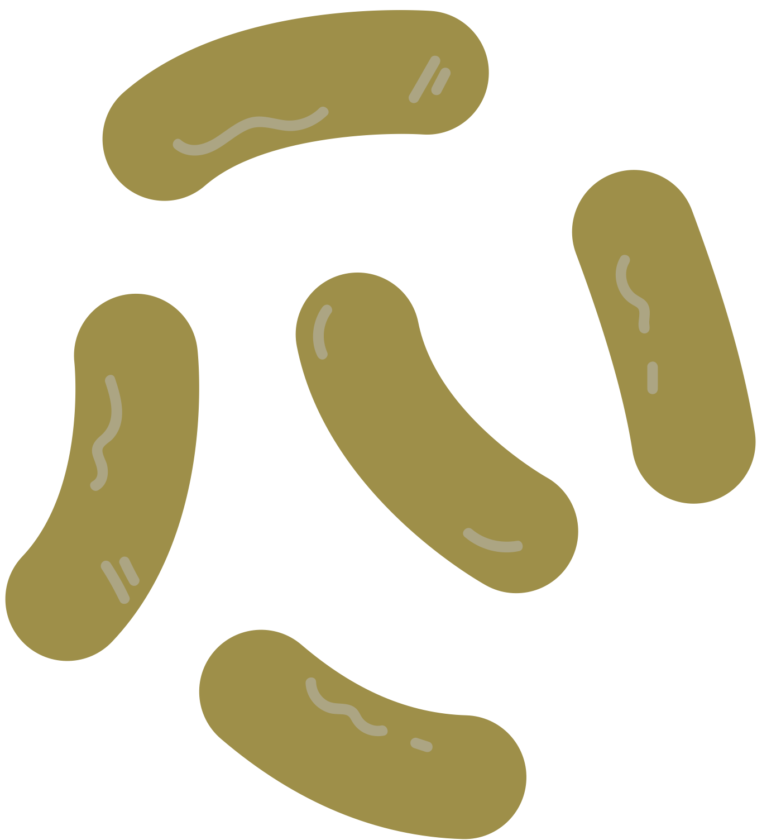
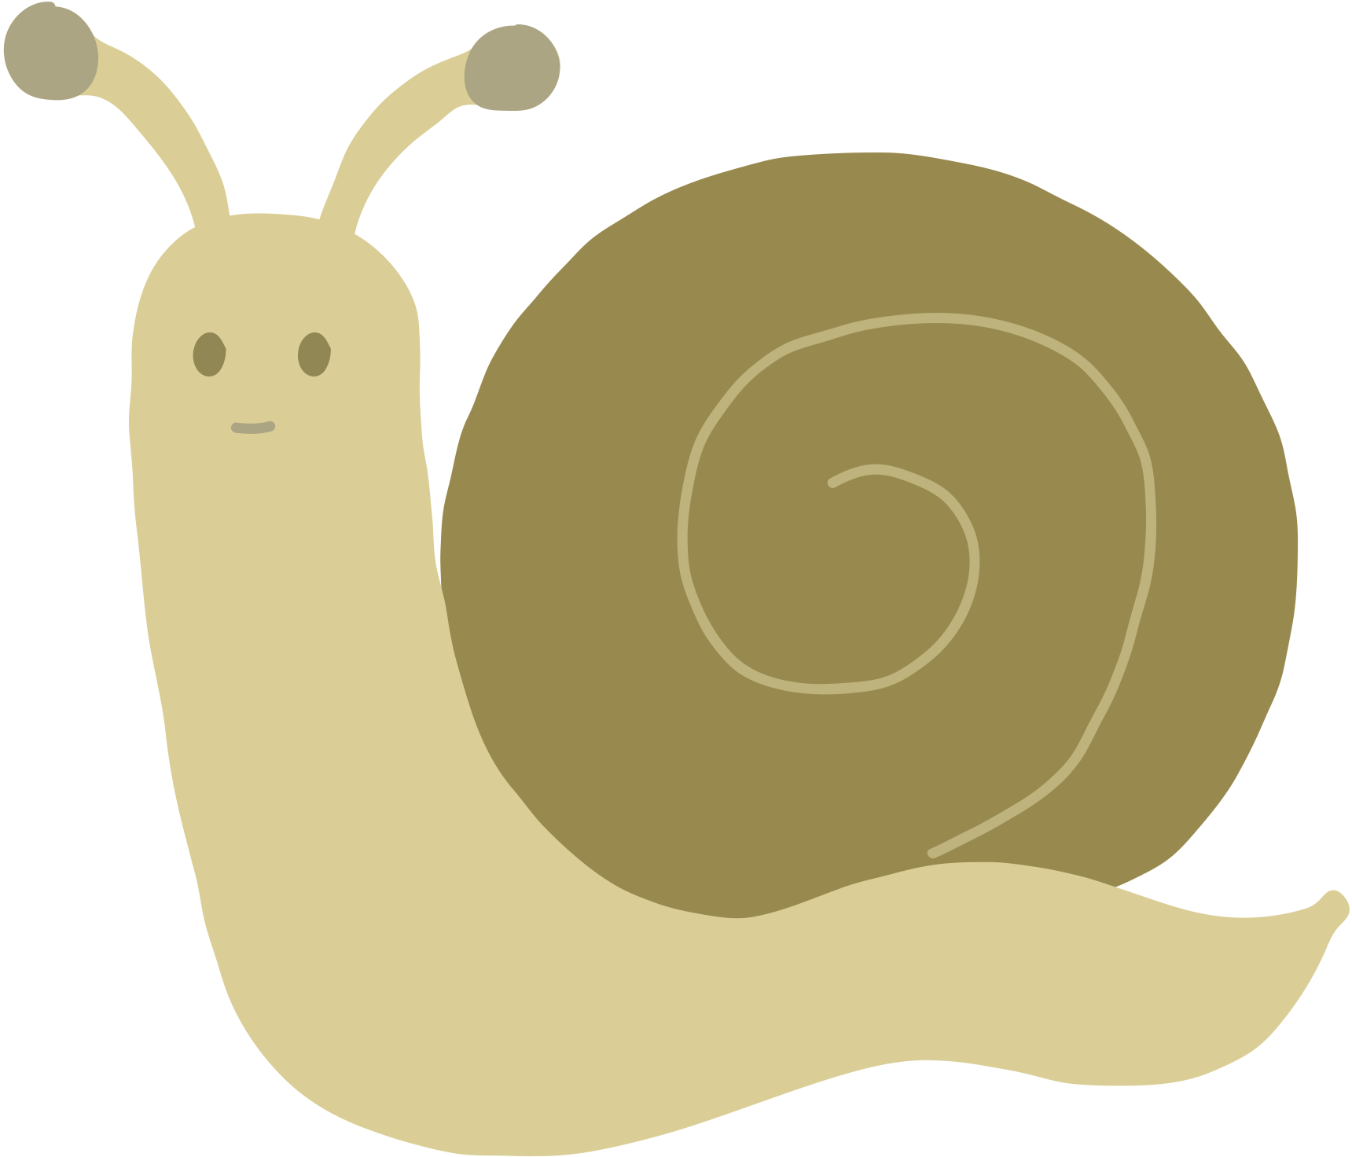
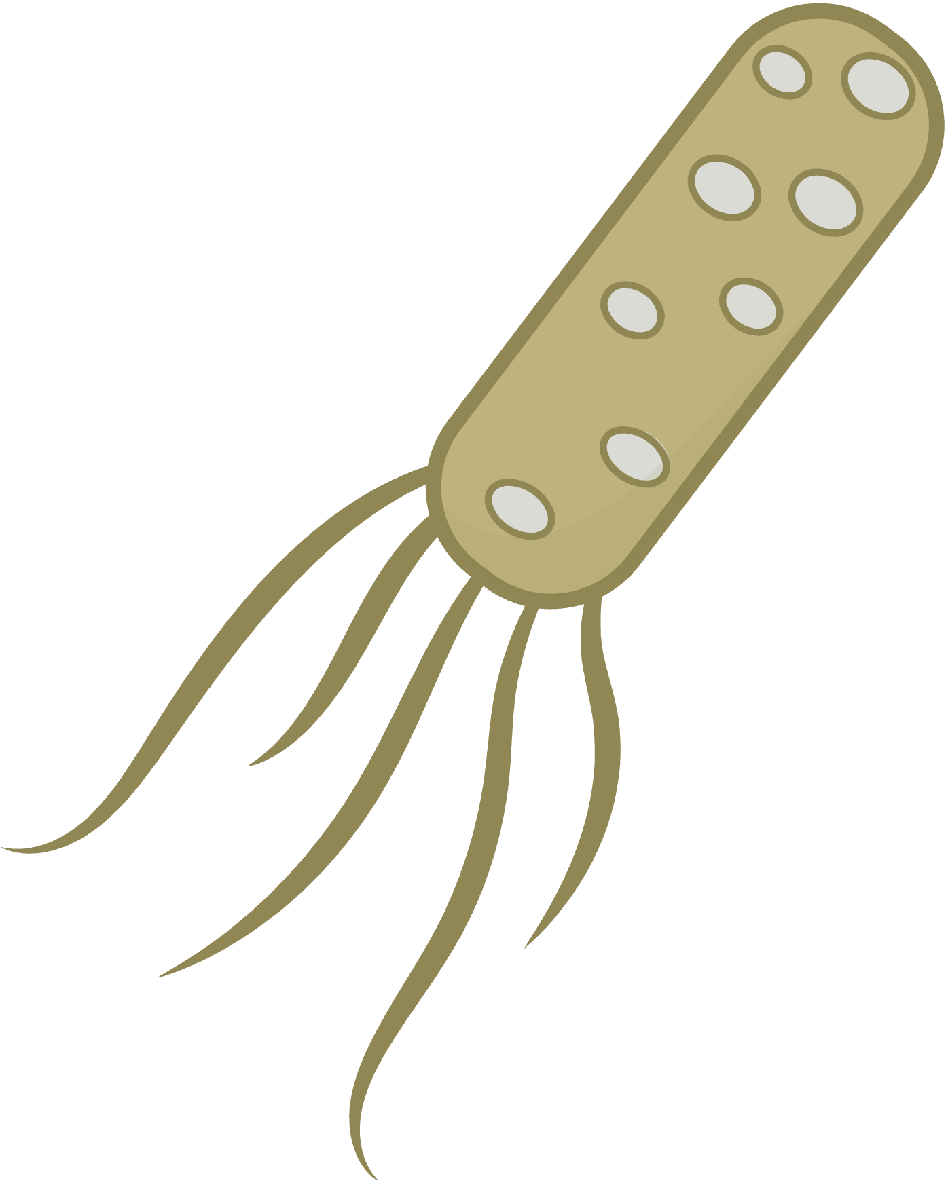

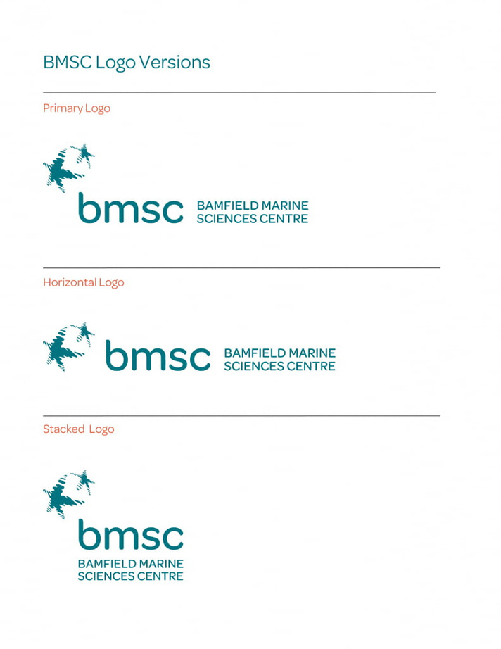

Who is living on the intertidal snail Nucella ostrina?
Tallis Dixon
Primary Supervisor: Dr. Louis Gosselin
Co-Supervisor: Dr. Eric Bottos

Slide 2
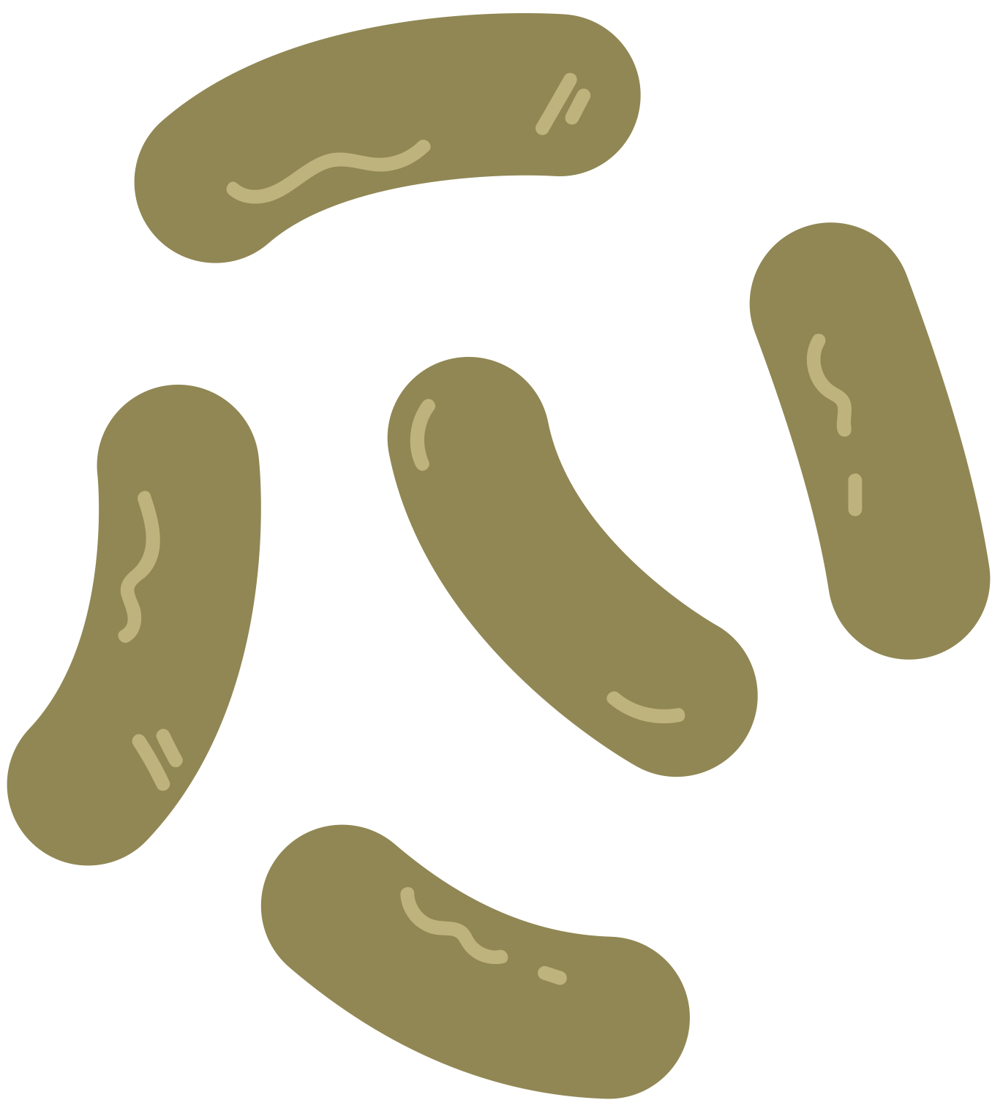
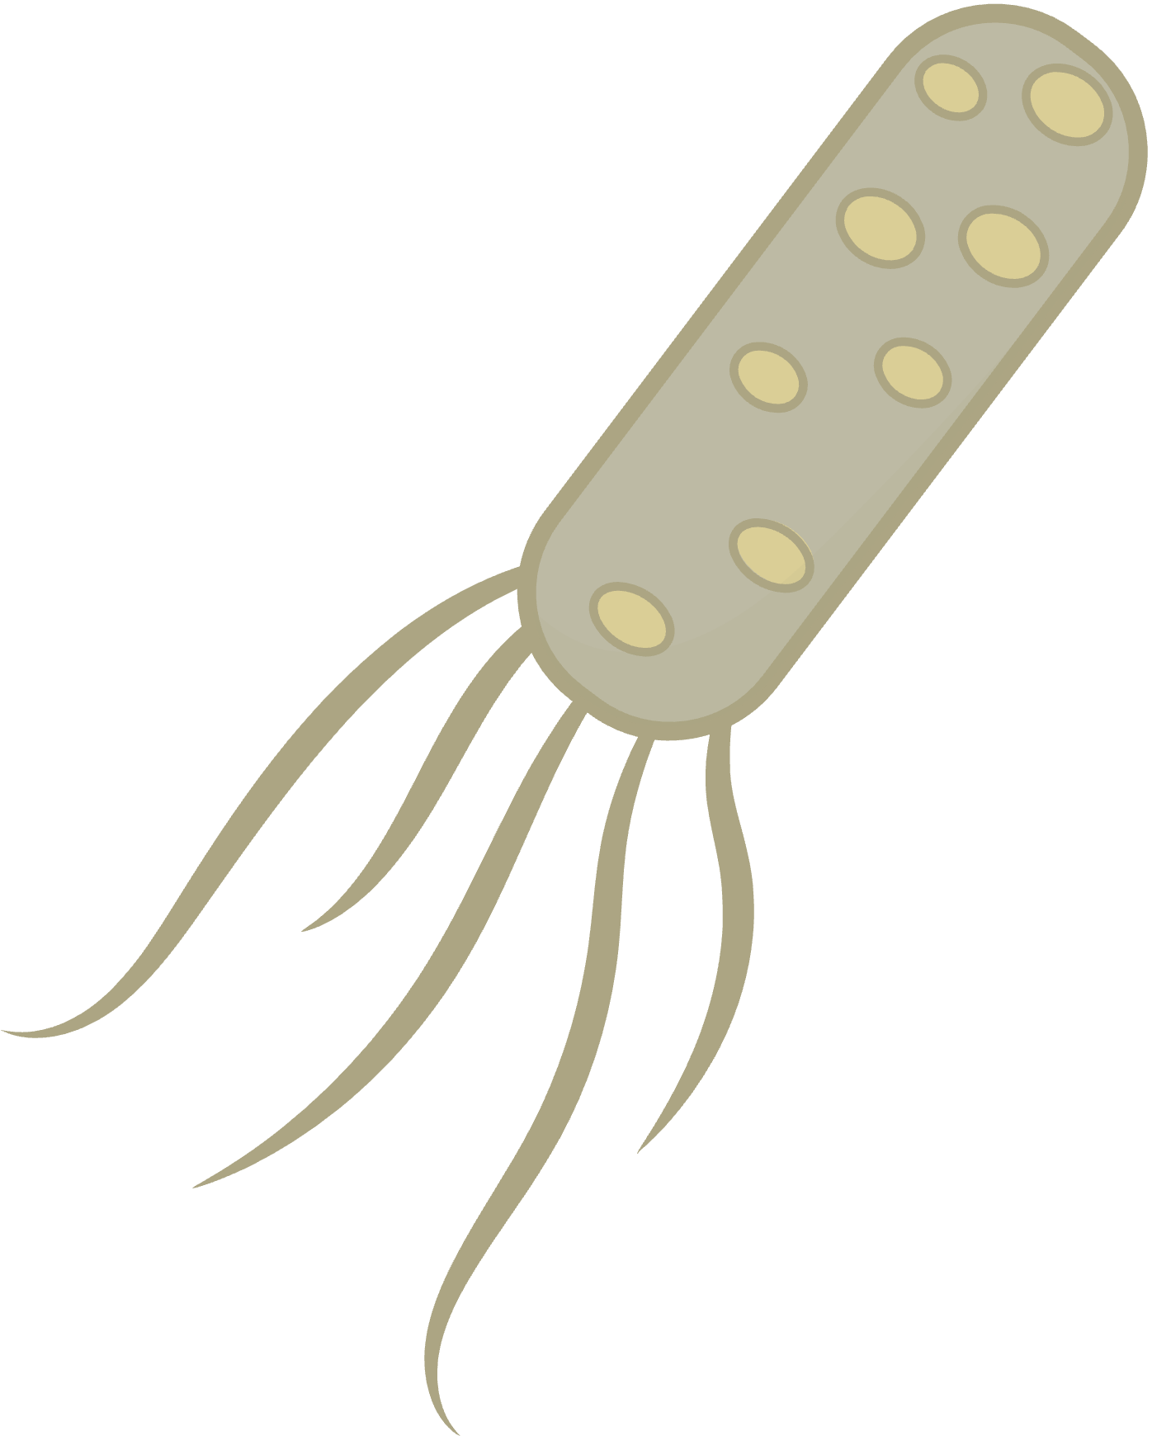

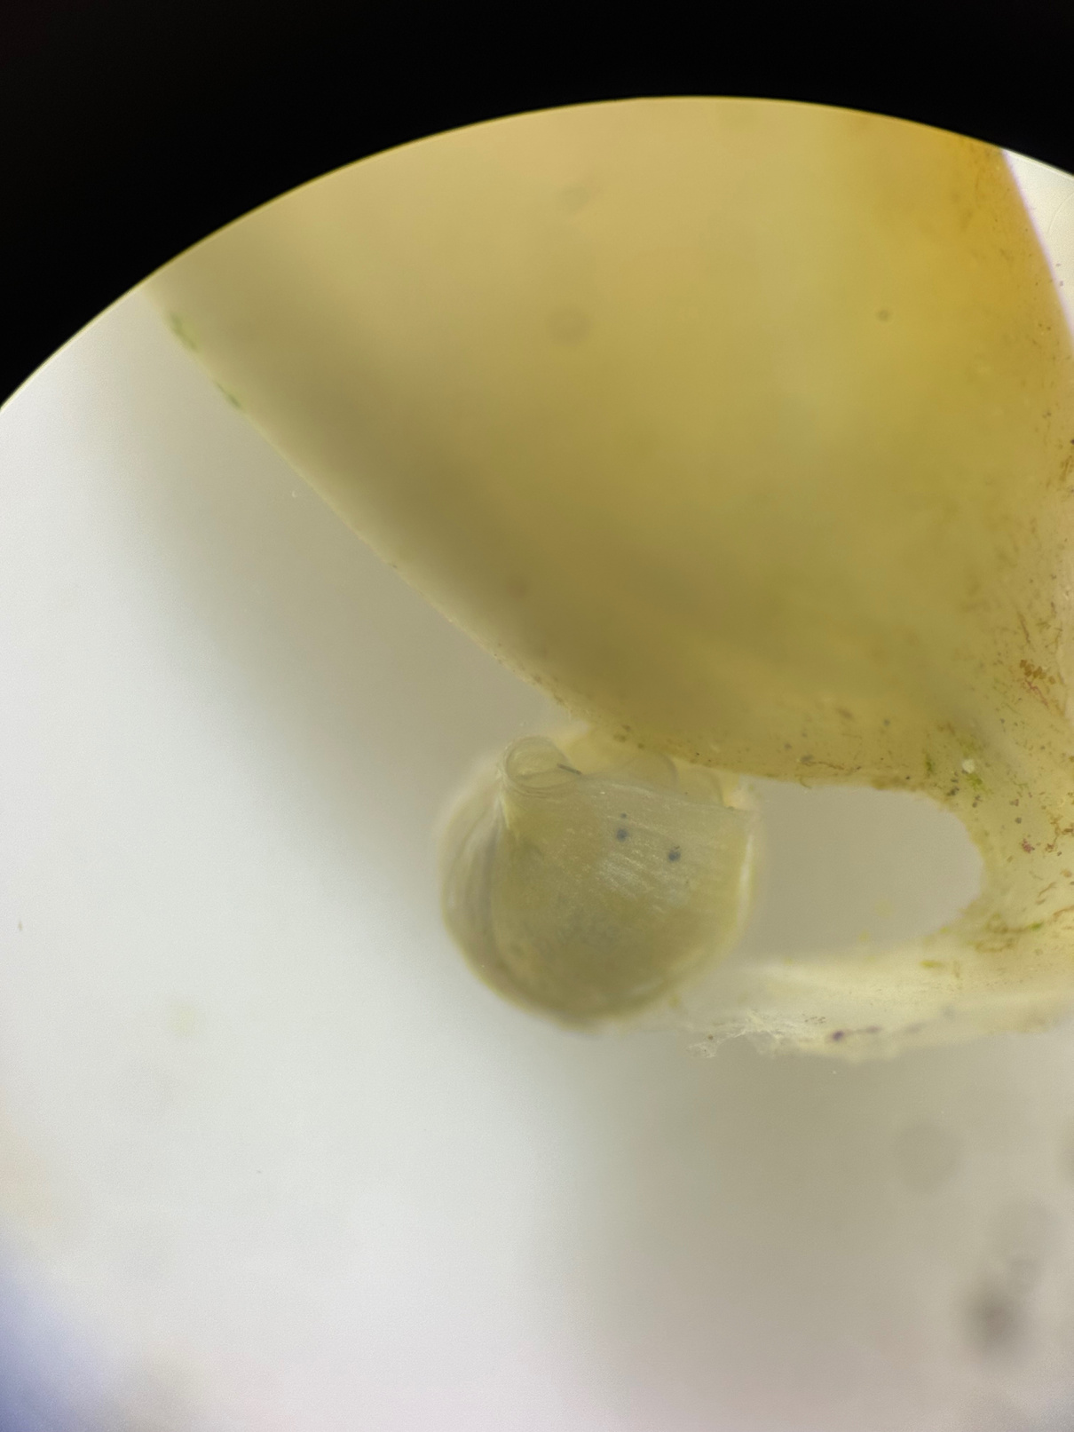
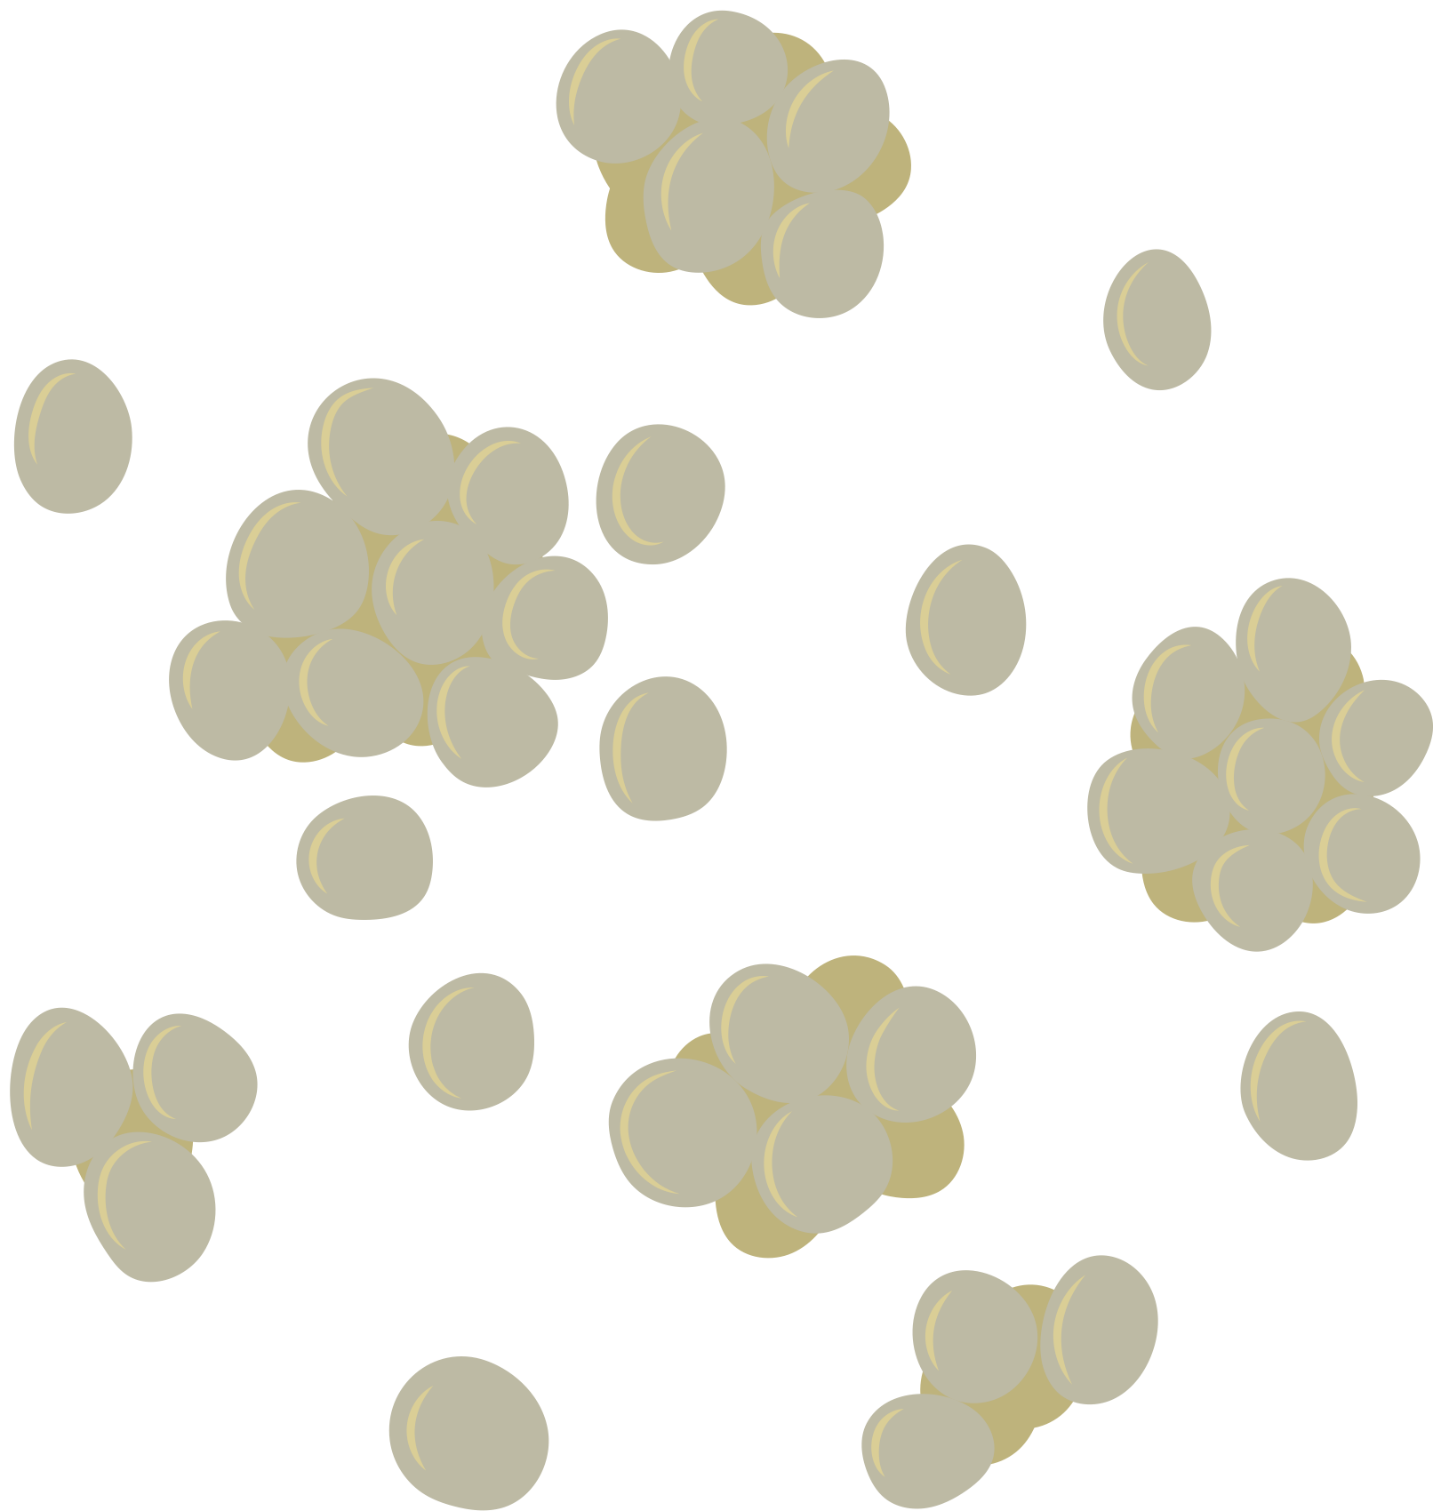
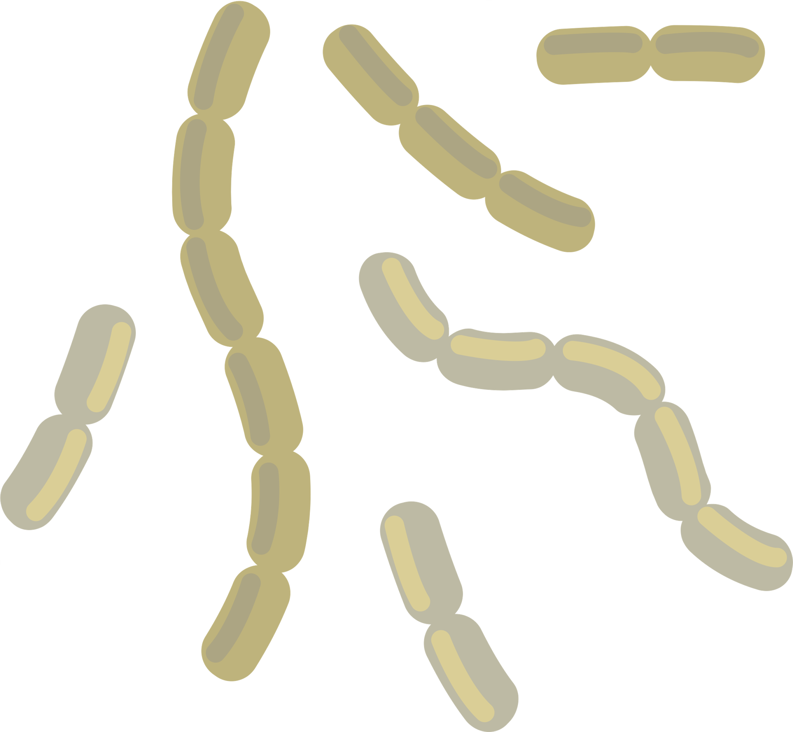
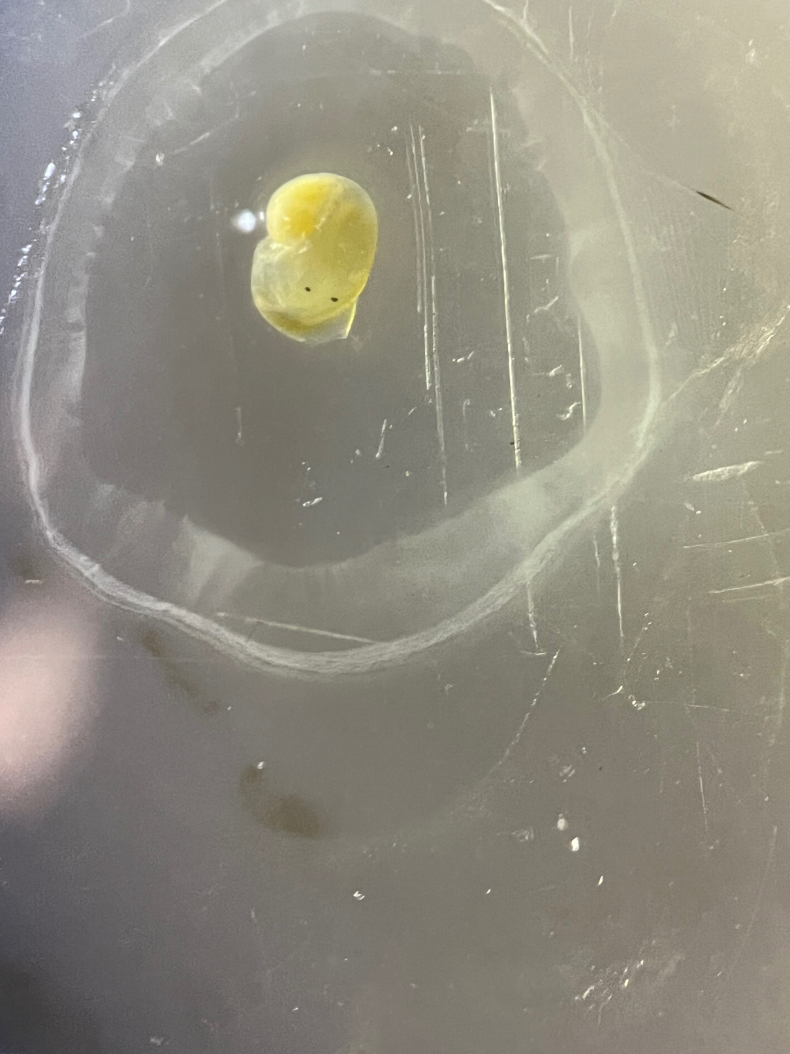
Background
Marine ecosystems harbour a diverse variety of bacterial communities - EVERYTHING has bacteria on it!
Some bacteria are harmful pathogens, others are beneficial and many have no effect.
Importance of the microbiome:
Immune defence
Digestion
Better environmental adaptations
Previous studies have examined:
Gut microbiome - for human consumption
Adult life stage because it is more easily accessed - larger body mass
No study to date has investigated the outer microbiome of early juveniles, which is known to be the most vulnerable phase of the life cycle of marine invertebrates.

Slide 3
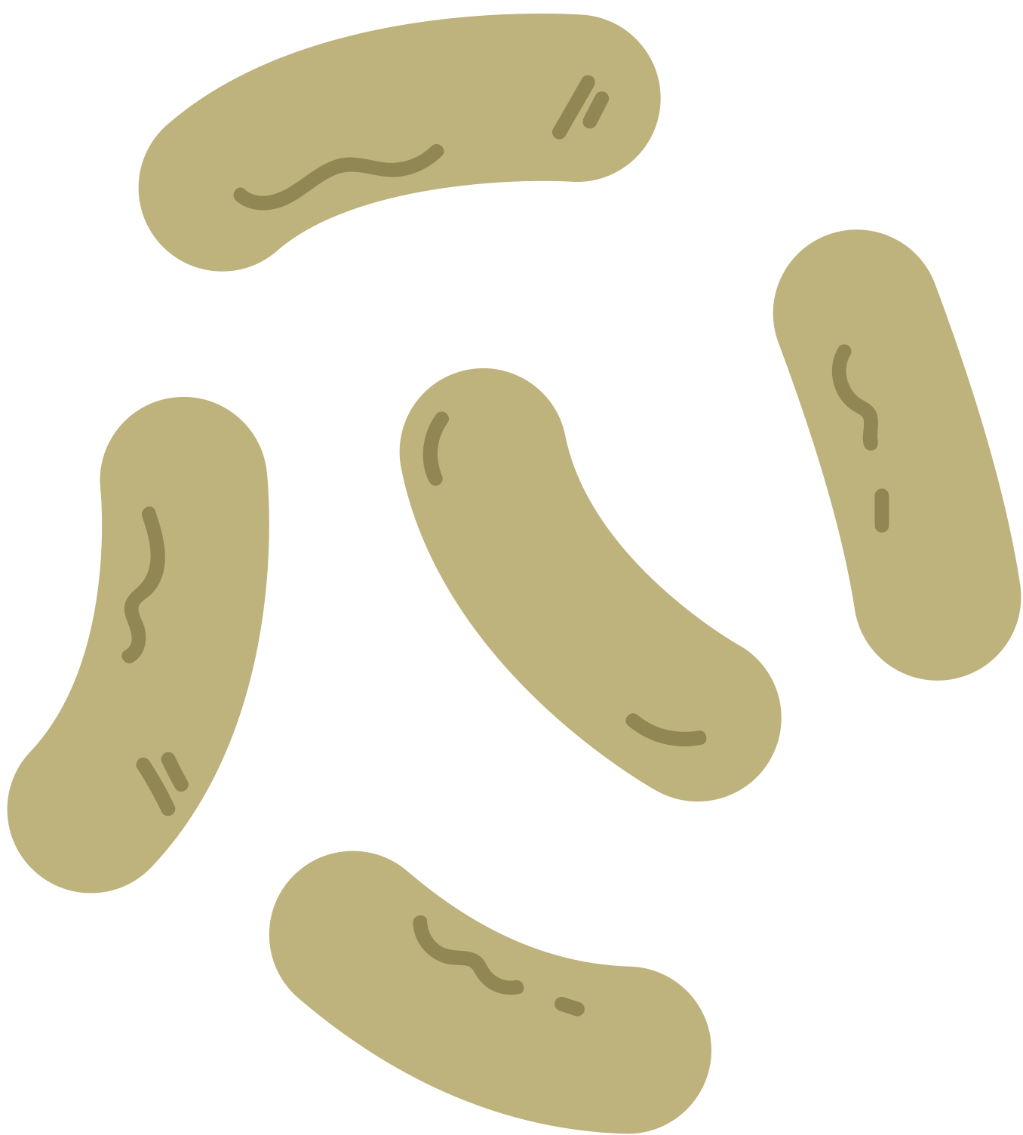
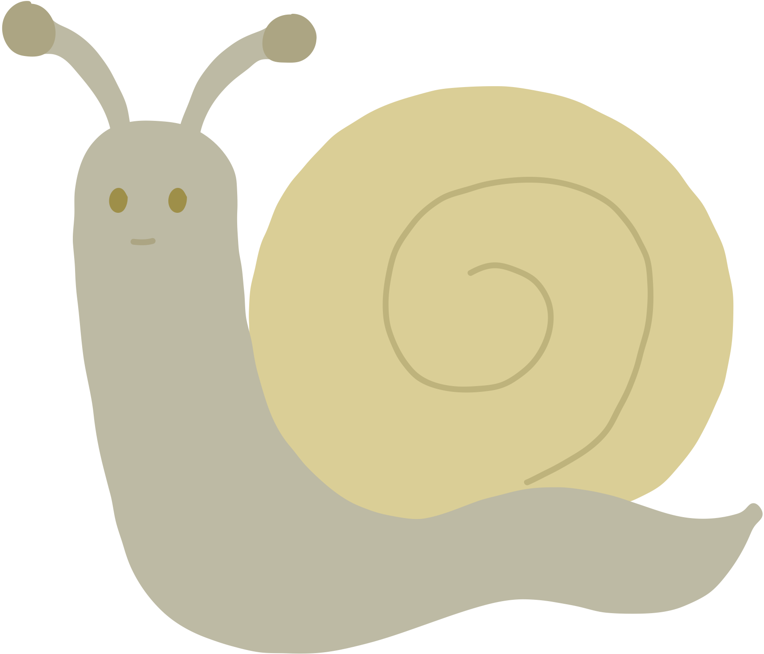
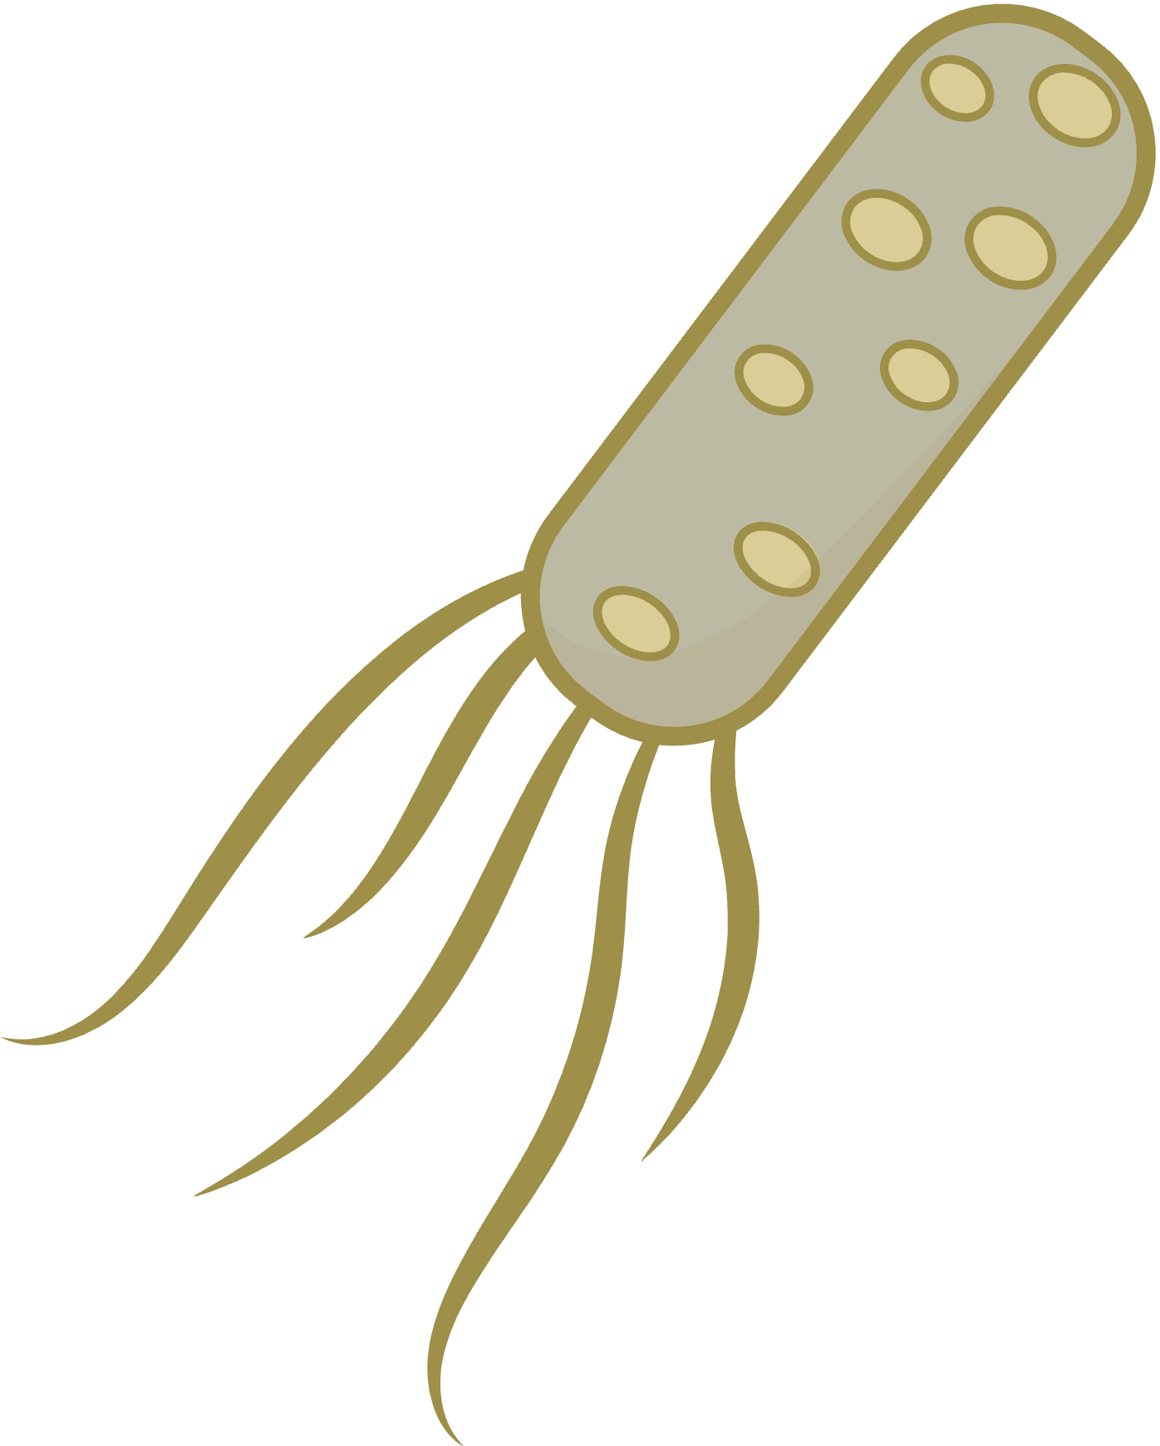
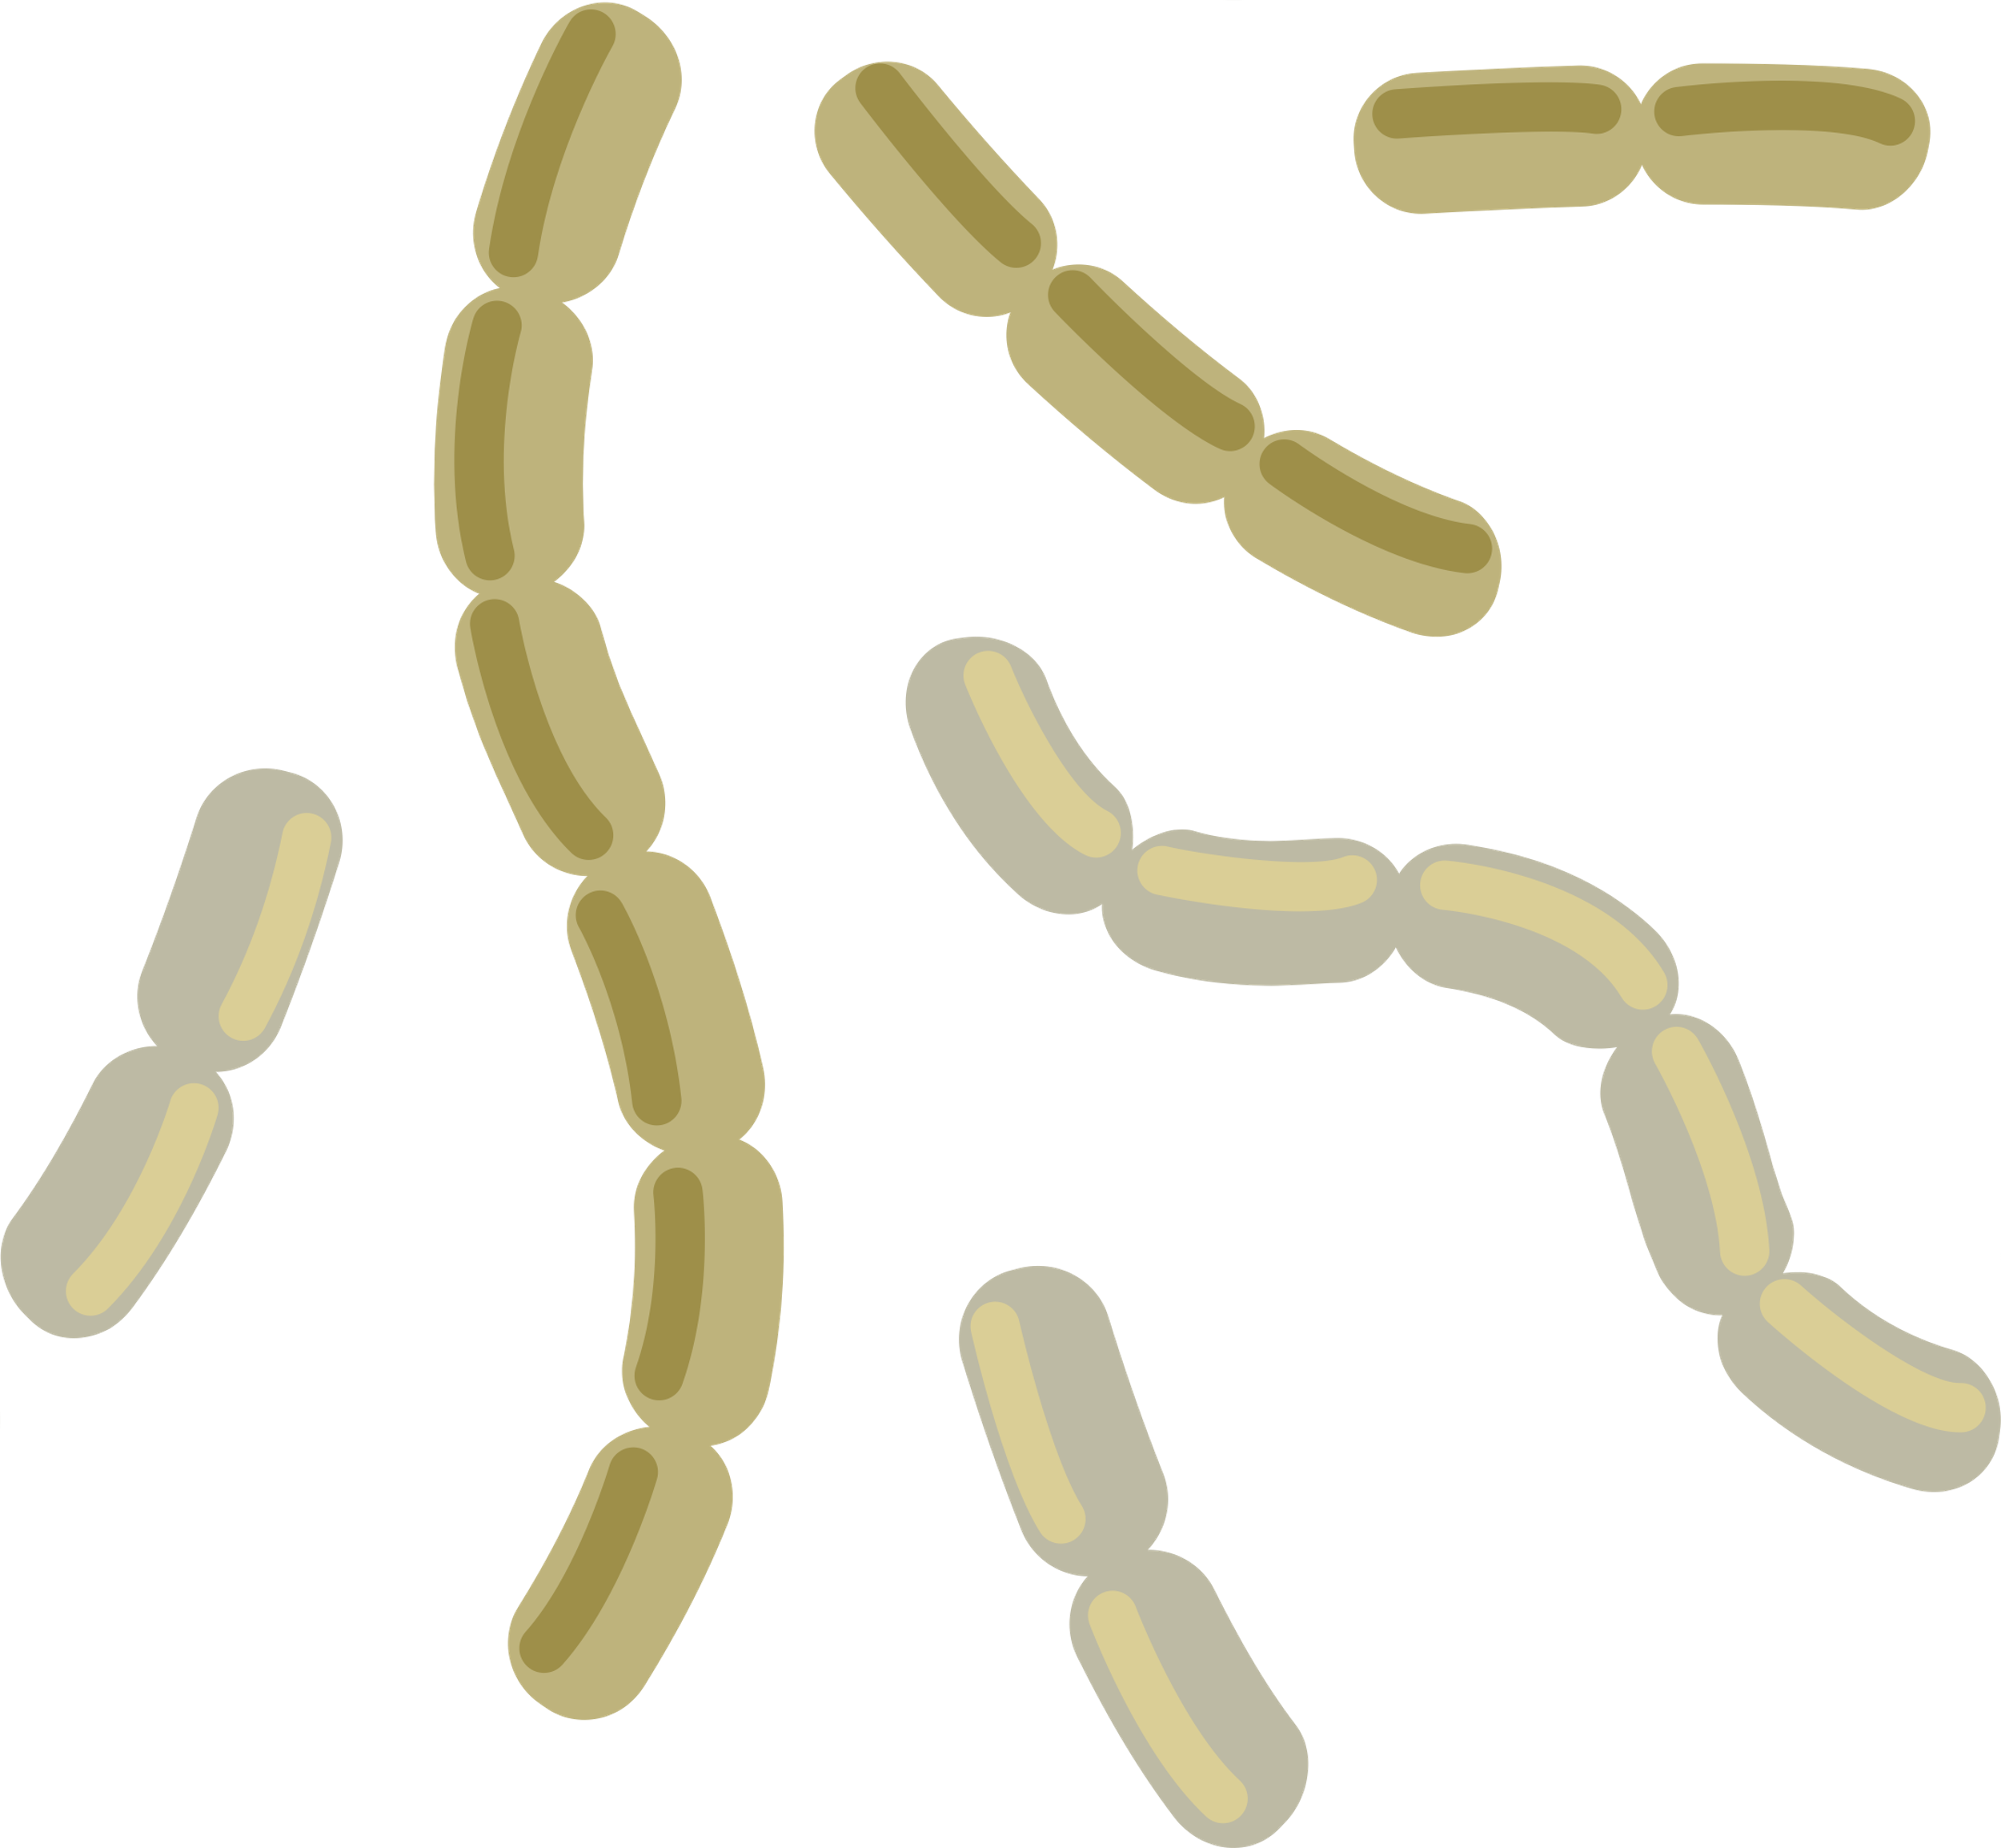

Research Question
What microbial communities make up the microbiome residing on the outside of the juvenile Nucella ostrina living in natural habitats?

Slide 4

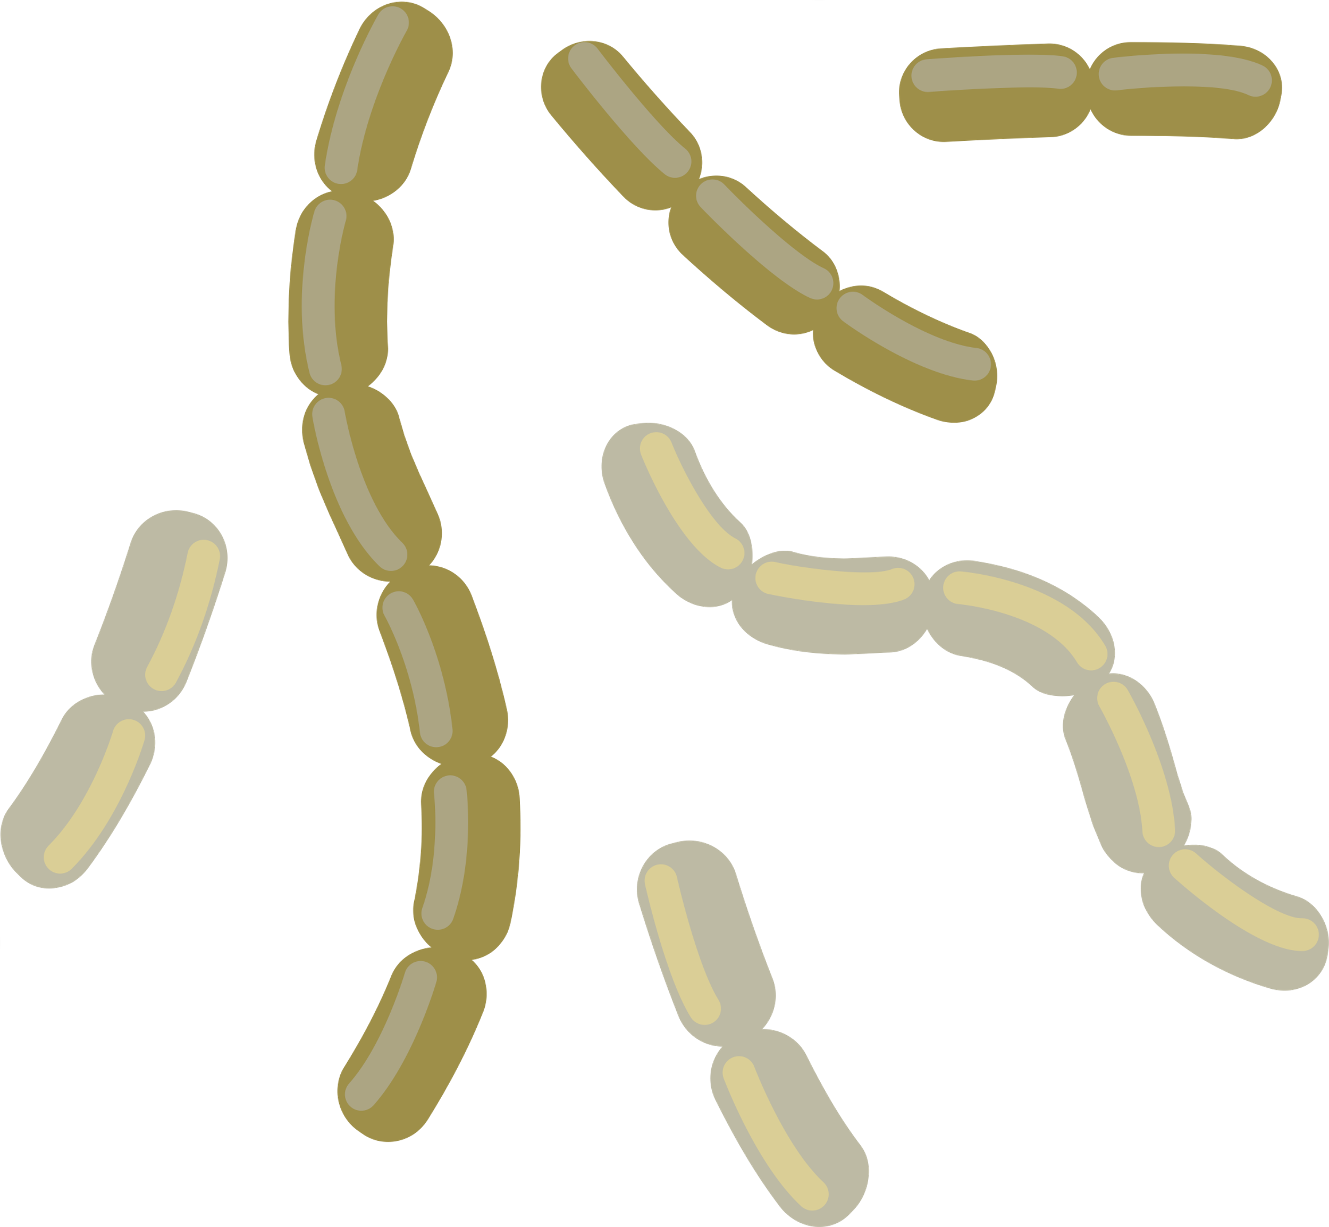


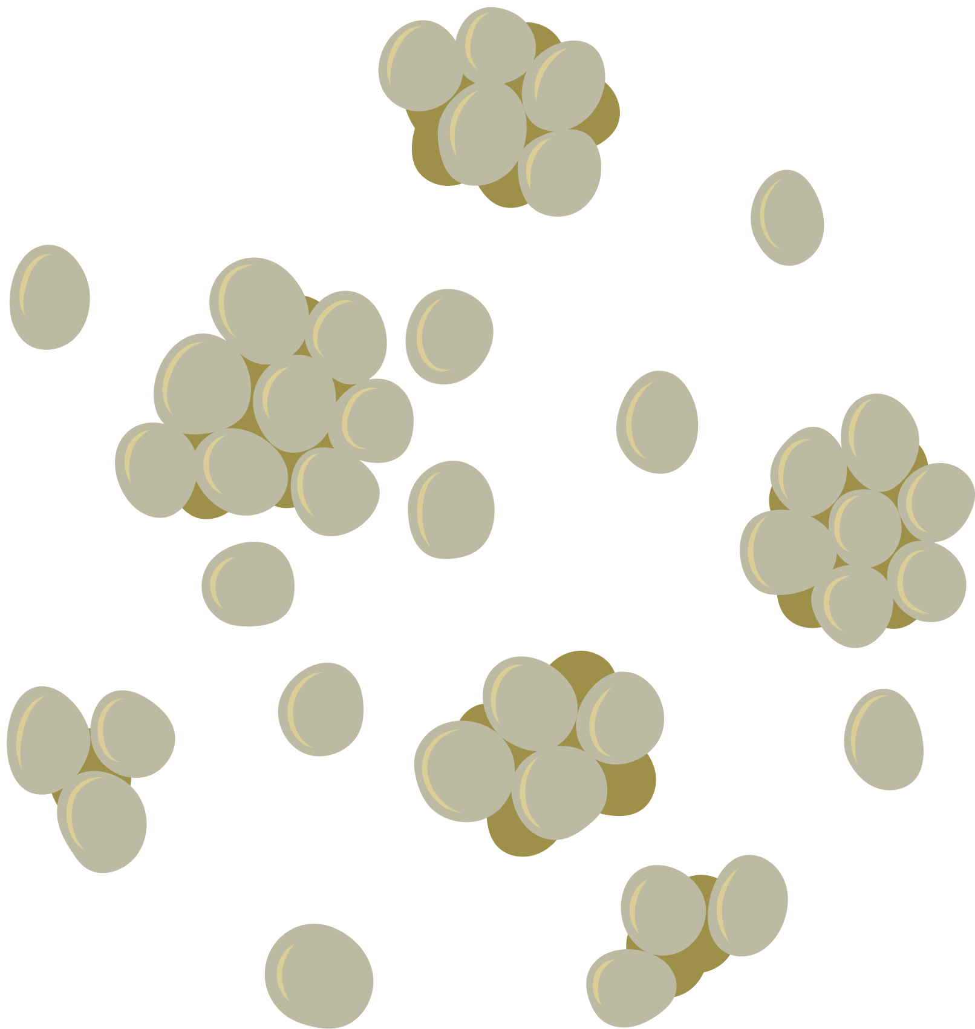

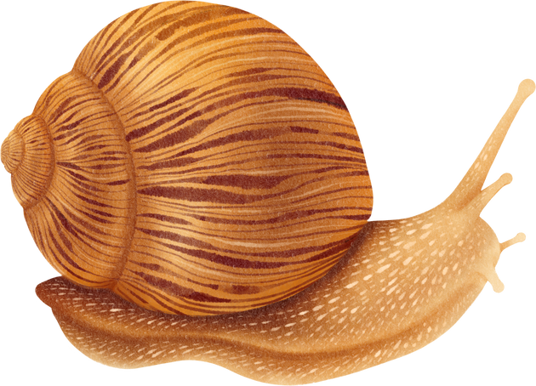
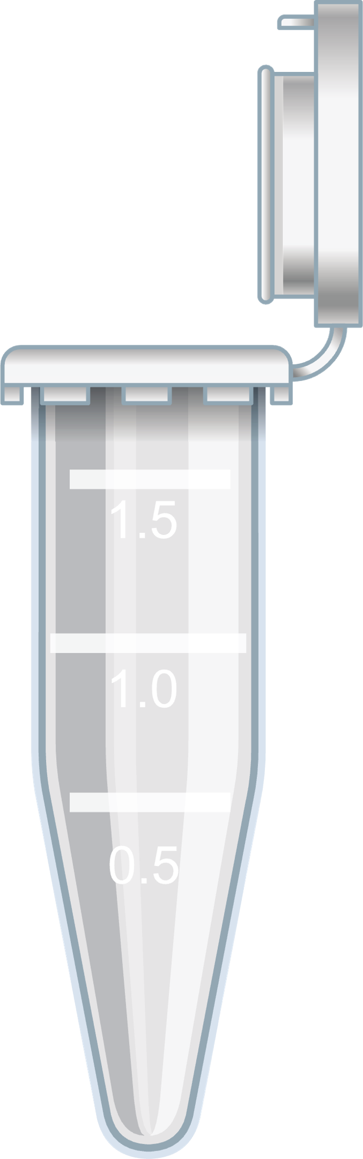
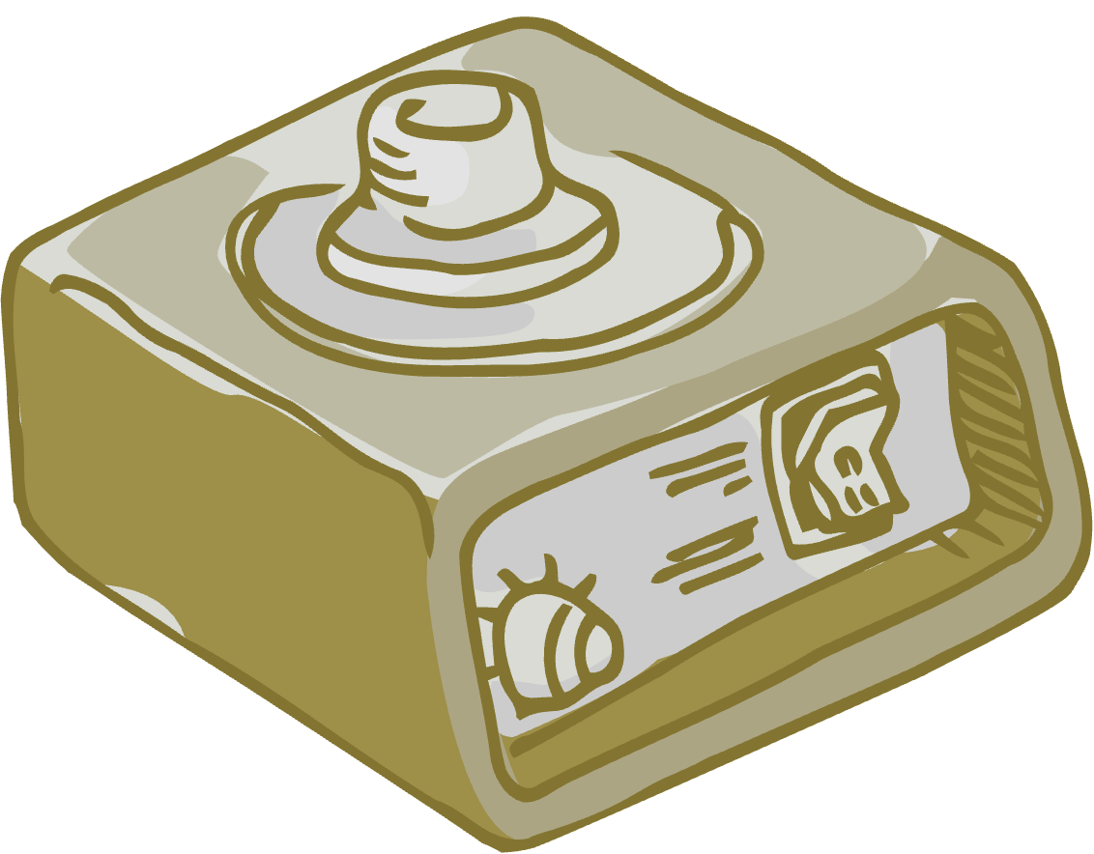
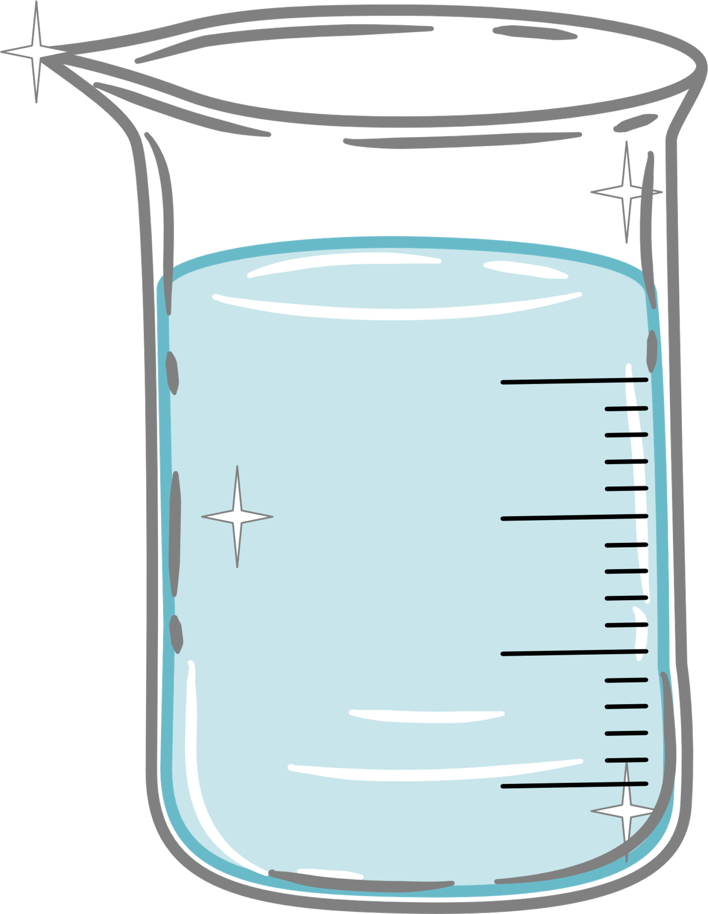

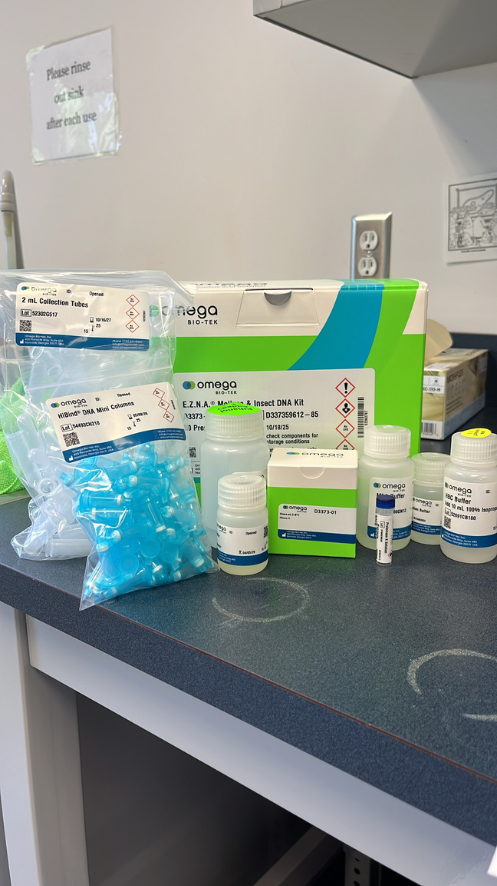


Methods
Animal
Collection
DNA
Extraction
DNA
Isolation
DNA
Sequencing
Challenges:
Extracting DNA from only the outer surface of juveniles
20 Juvenile Snails
Repeat 3X
1 mL Wash Water
Vortex 30 seconds
0.33 mL Sterile Sea Water
2. Removing mucopolysaccharides that inhibit PCR amplication
S
O
E
AND
E.Z.N.A Mollusc & Insect DNA Kit
4 sample types 1 mL solution in each, S (Seawater), E (entire microbiome), O (outer microbiome)
Centrifuged at max for 10 minutes until pellet formed

Slide 5
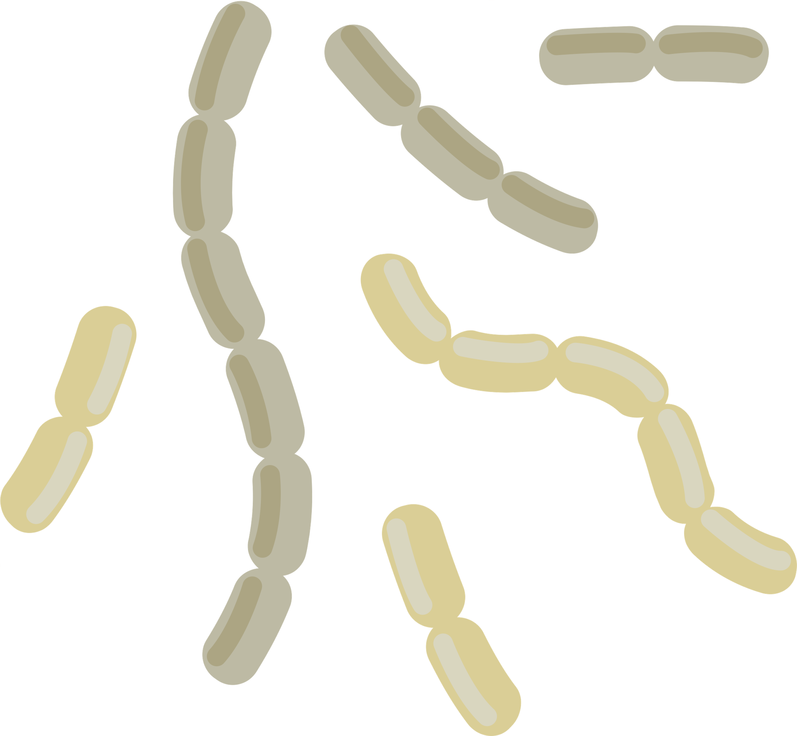


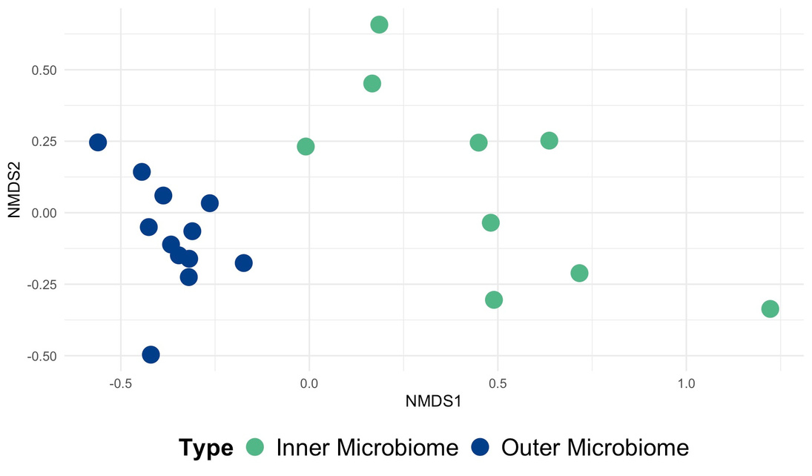
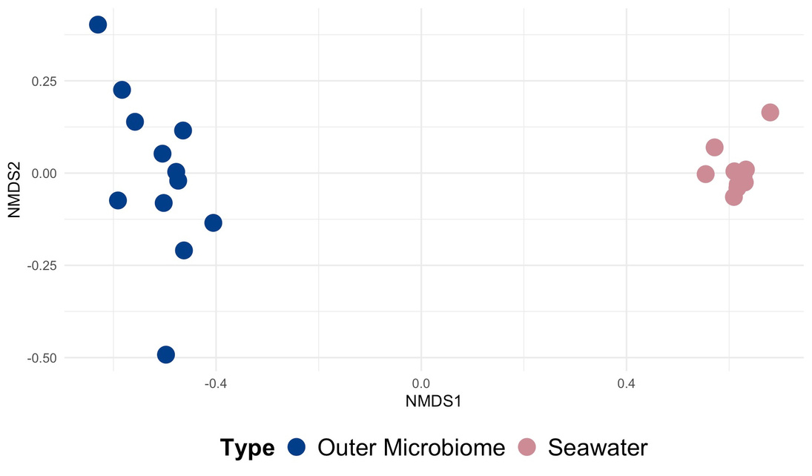



Results
Figure 1. NMDS plot showing the community composition of the outer microbiome and the seawater samples.
Figure 2. NMDS plot showing the community composition of the outer microbiome and the inner microbiome samples.

Slide 6
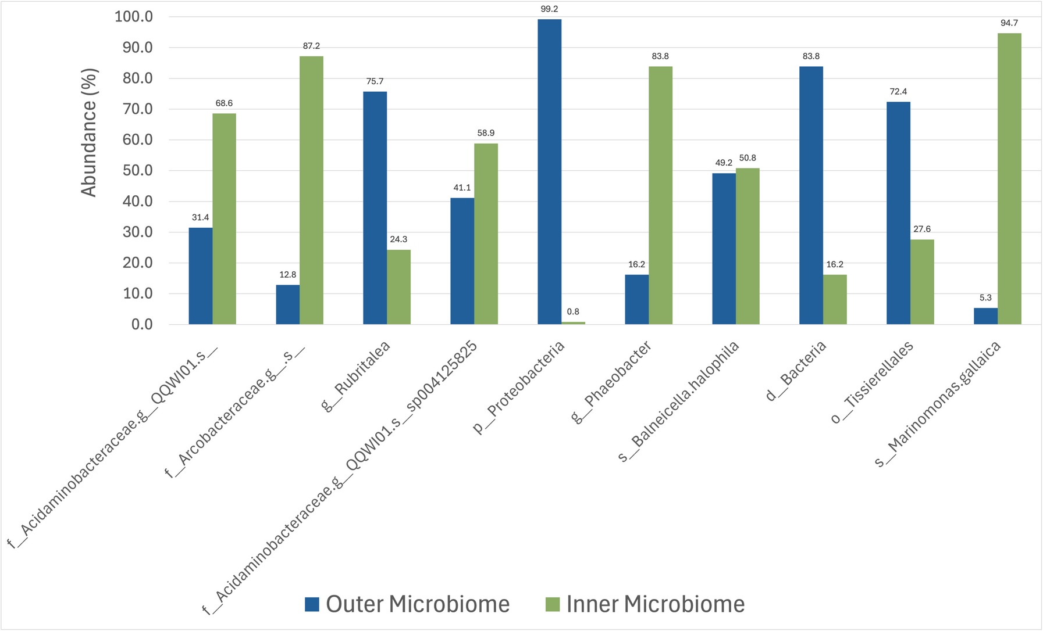
Results-Con’t
Table 1. showing the relative numbers of OTUs (operational taxonomic units) making up the differences in Figure 3.
# of OTUs making up 46.3% of the obversed differences | Total OTUs
10 | 5340
Permanova Results:
R2 = 38.3%
F = 11.8
p-value = 0.001***
Figure 3. Relative abundance of the top 10 OTU’s making up the differences in the outer microbiome and the inner microbiome.

Slide 7
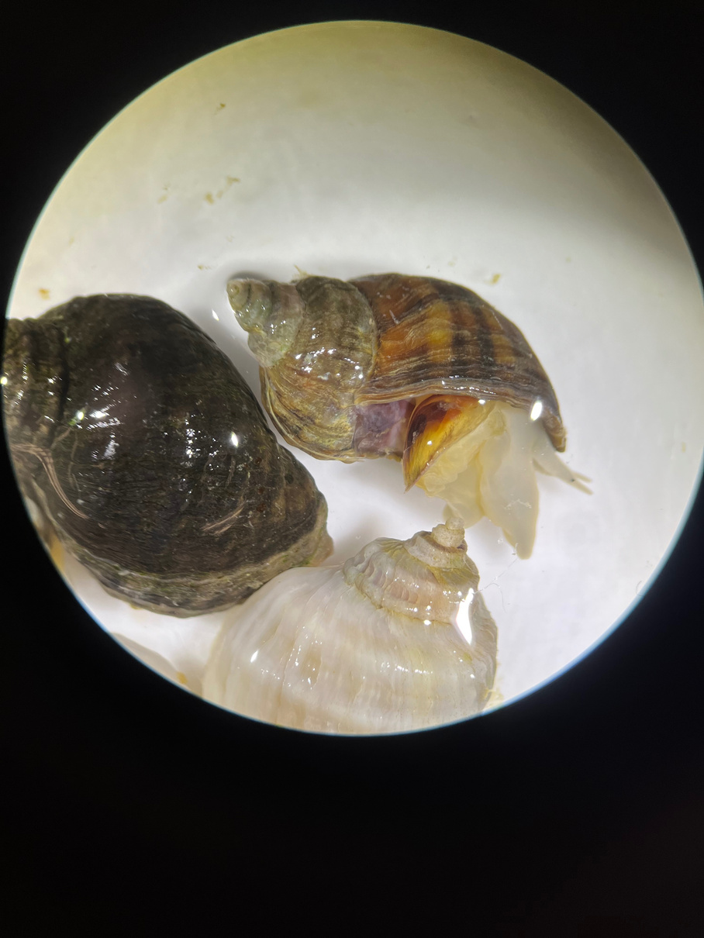
Discussion
This study demonstrates that the microbiome on the exterior of juvenile invertebrates is significantly different from their internal microbiome.
This is important because it provides insights into the potential roles of early microbial colonizers in shaping juvenile health and survival, possibly by outcompeting pathogenic bacteria.
Future research will investigate how the outer microbiome shifts from juveniles to adults as they transition from sheltered to more exposed environments, and how these changes may influence their microbial communities.

Slide 8
References
Gosselin LA, Qian PY. 1997. Juvenile mortality in benthic marine invertebrates. Marine Ecology Progress Series. 146:265-282. http://faculty.tru.ca/lgosselin/publications/gosselin&qian_1997_meps_146_265-282.pdf
Gosselin LA, Chia FS. 1993. Feeding habits of newly hatched juveniles of an intertidal predatory gastropod, *Nucella emarginata* (Deshayes). Journal of Experimental Marine Biology and Ecology. 176.http://www.tru.ca/faculty/lgosselin/publications/gosselin&bourget_1989_jouranimecol_5 8_287-303.pdf
De Castro-Fernández P, Ballesté E, Angulo-Preckler C, Biggs J, Avila C, García-Aljaro C. 2023. How does heat stress affect sponge microbiomes? Structure and resilience of microbial communities of marine sponges from different habitats. Frontiers in Marine Science. 9. https://doi.org/10.3389/fmars.2022.1072696
Iwabuchi BL, Gosselin LA. 2019. Long-term trends and regional variability in sea surface temperature, salinity, and intertidal rock temperature on Vancouver Island, Canada. Bulletin of Marine Science. 95:337-354.https://www.ingentaconnect.com/content/umrsmas/bullmar/2019/00000095/00000003/ art00001
Liu M, Li Q, Tan L, Wang L, Wu F, Li L, Zhang G. 2023. Host-microbiota interactions play a crucial role in oyster adaptation to rising seawater temperature in summer. Environmental Research. 216. https://doi.org/10.1016/j.envres.2022.114585
Khan B, Clinton SM, Hamp TJ, Oliver JD, Ringwood AH. 2018. Potential impacts of hypoxia and a warming ocean on oyster microbiomes. Marine Environmental Research. 139:27–34. https://doi.org/10.1016/j.marenvres.2018.04.018

Slide 9


Questions?

