Slide 1
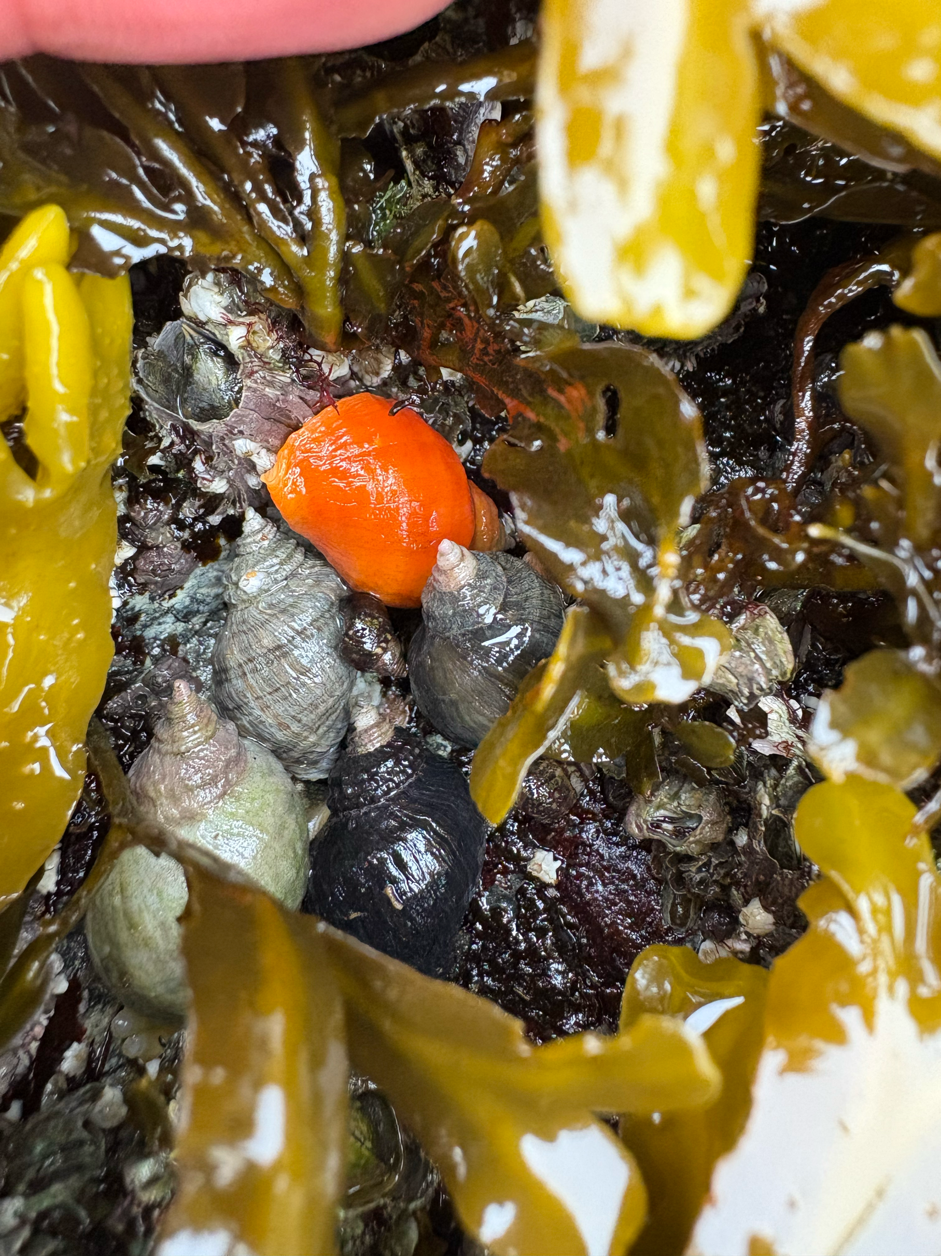
Determination of Triglyceride lipid levels in Nucella ostrina using quantitative NMR spectroscopy
Tallis Dixon
Supervisor: Dr. Louis Gosselin
Co-Supervisor: Dr. Bruno Cinel

Slide 2
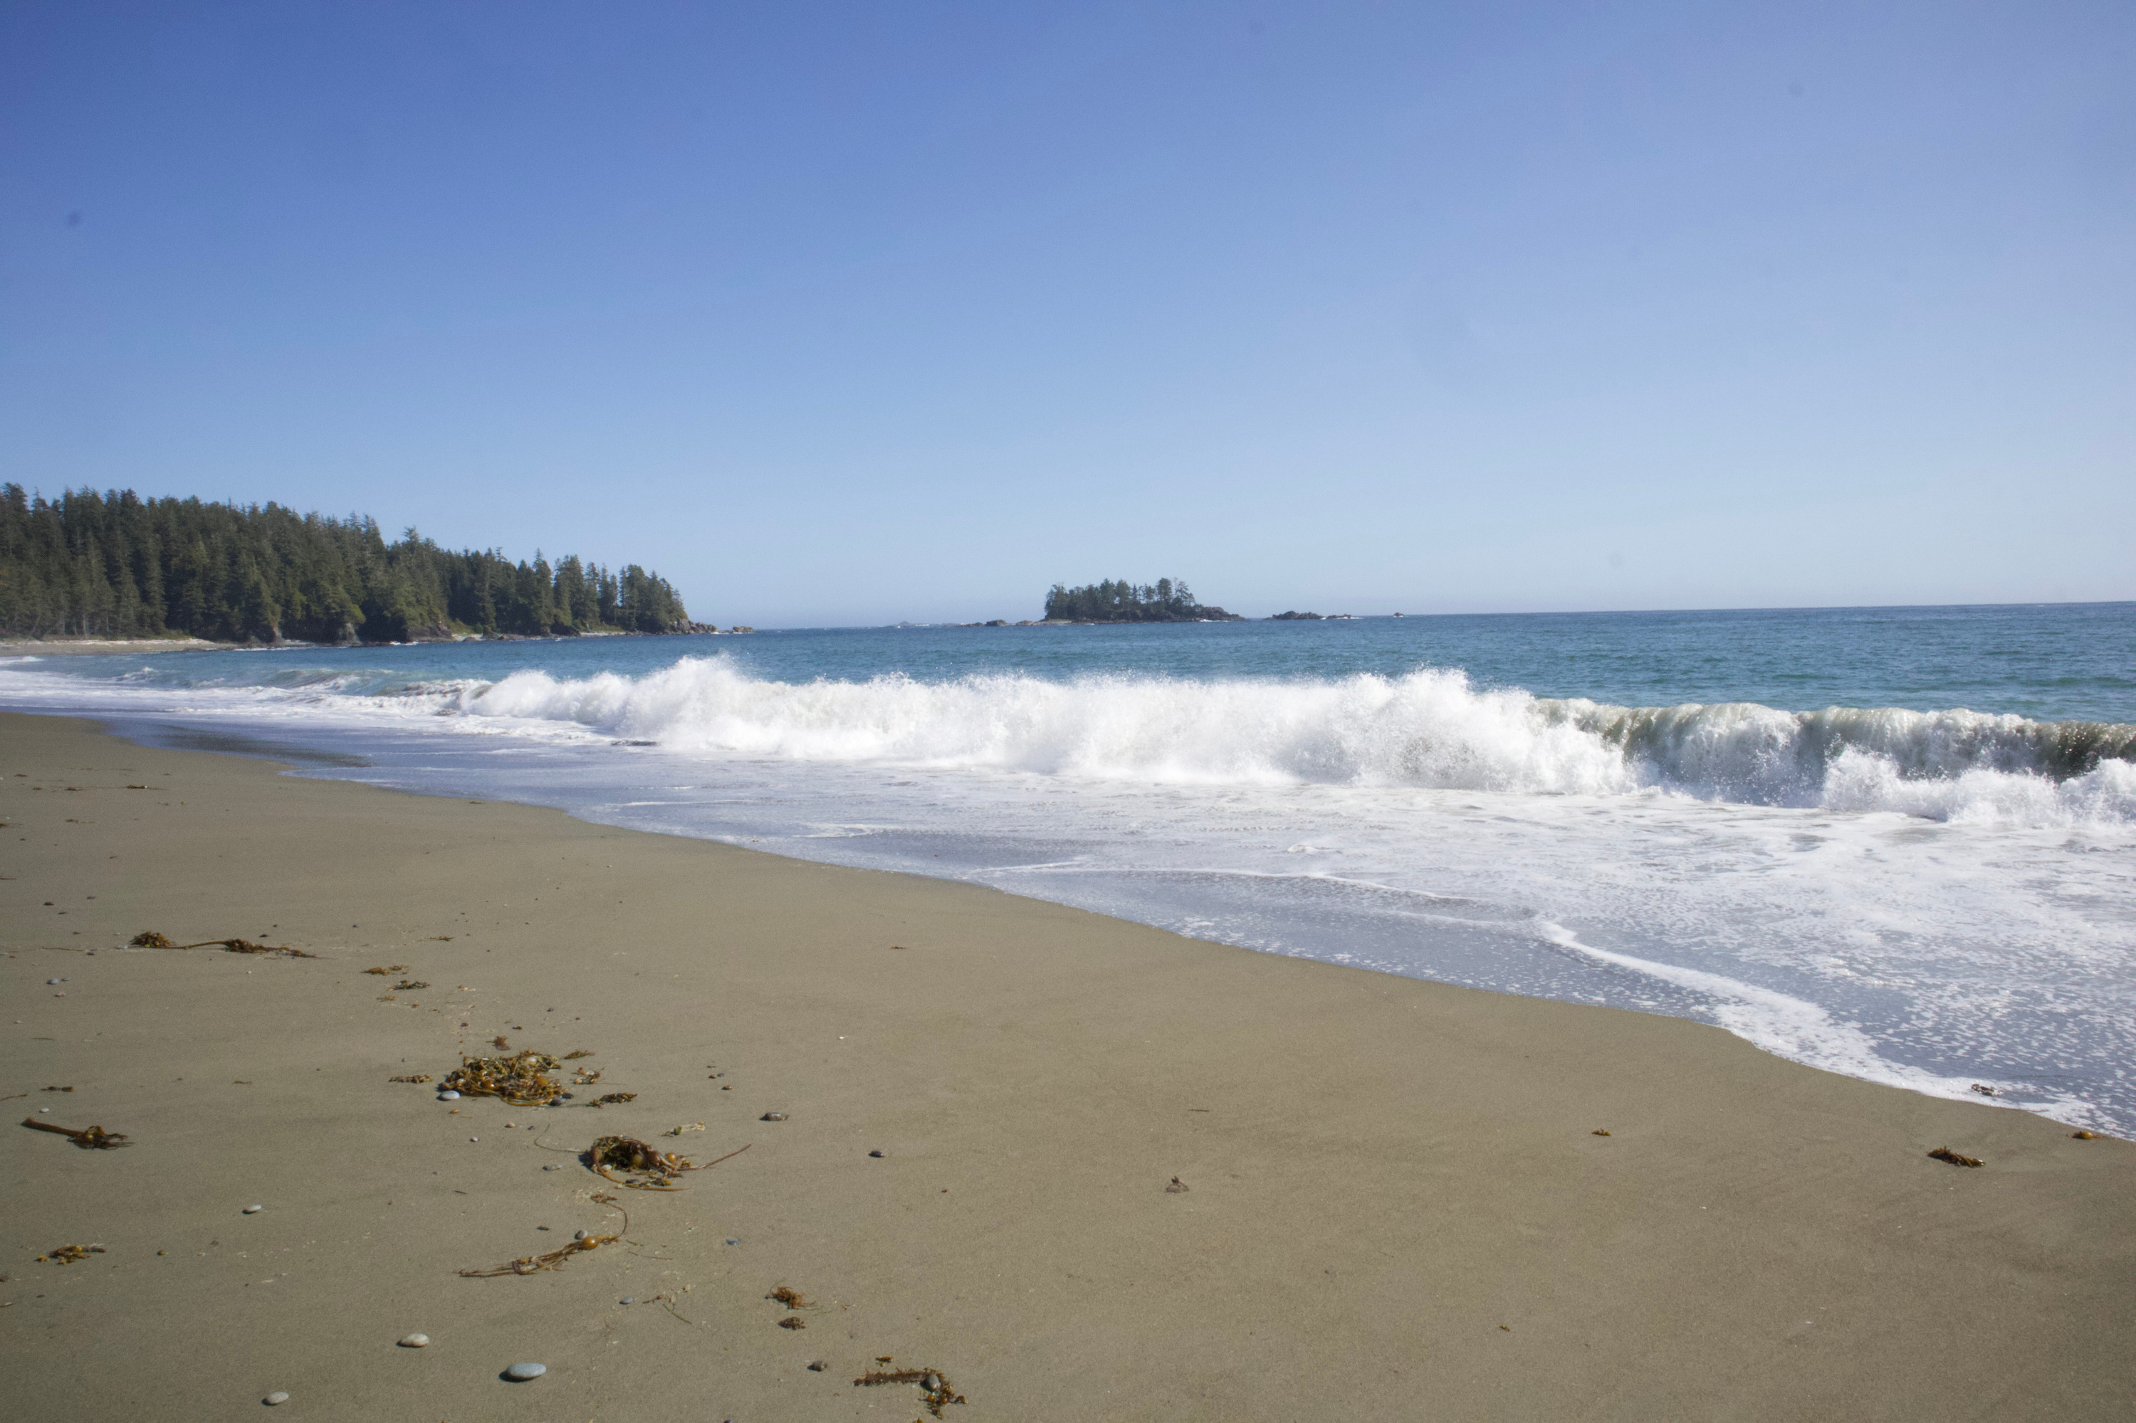
The Importance of BC’s Intertidal Ecosystem
The intertidal zone on the west coast of North America, including BC, is home to the largest biodiversity of intertidal marine organisms in the world. 2
This is due to:
  Mild, moist temperatures throughout the year
  Upwelling currents bring nutrient-dense water to shallower areas1
  Good rocky substrate for organisms to attach1,2

Slide 3

Threats to the Intertidal Zone
Global Warming
  Ocean temperatures are predicted to increase 1 °C per century 1
  With the twice-daily exposure to air temperature in the intertidal zone, animals must tolerate hotter air and water temperatures 1
  Therefore, intertidal organisms could serve as critical markers for how climate change is affecting this ecosystem

Slide 4
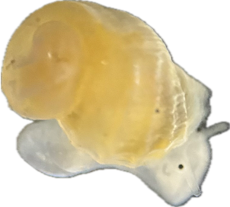

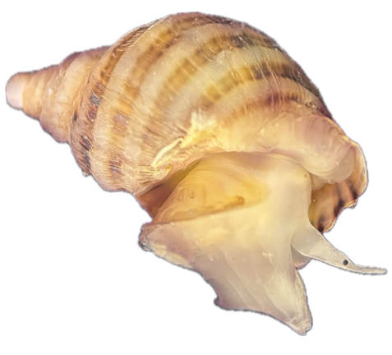


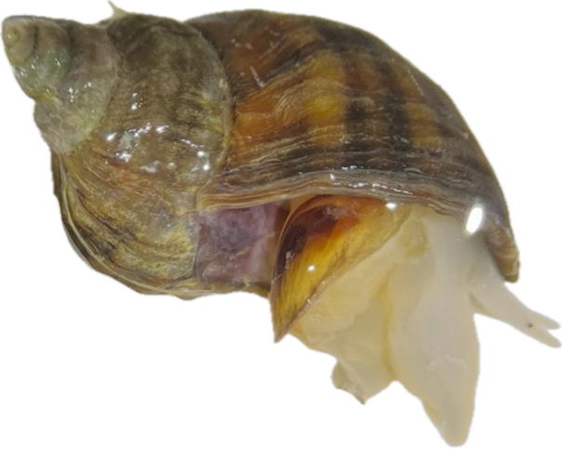
Helps them grow and survive until they start hunting
How do marine invertebrates survive stress?
Early Juvenile
ENERGY!
Late
Juvenile
  Energy is acquired through nutrients and stored as triglycerides
Transfer of energetic lipids to offspring
  The greater the energy store the greater amount of time the animal can survive under stress
Adult

Slide 5
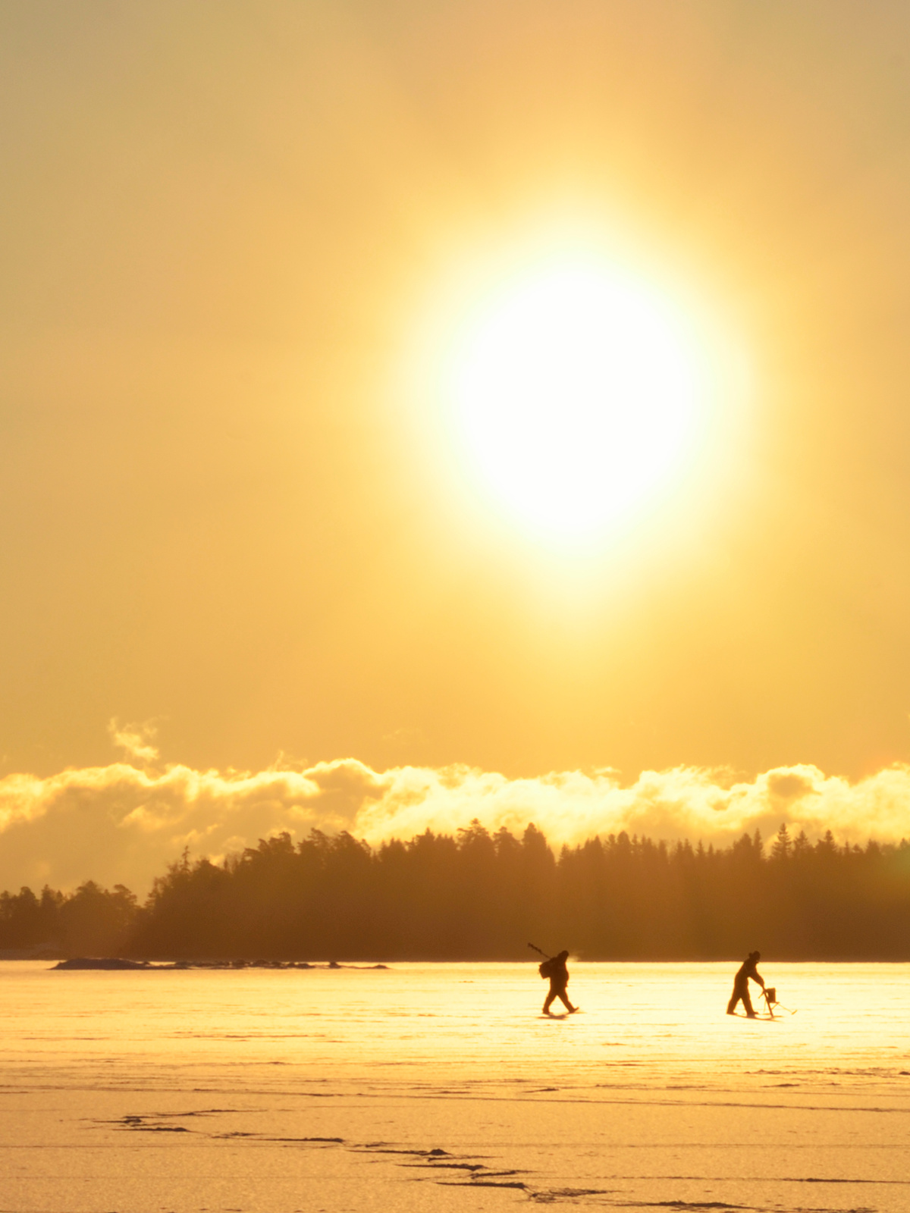
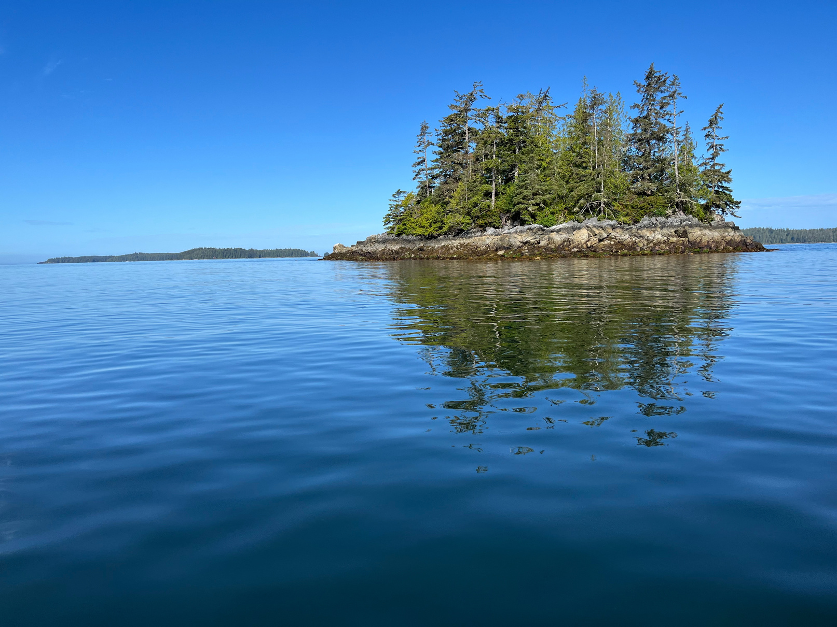
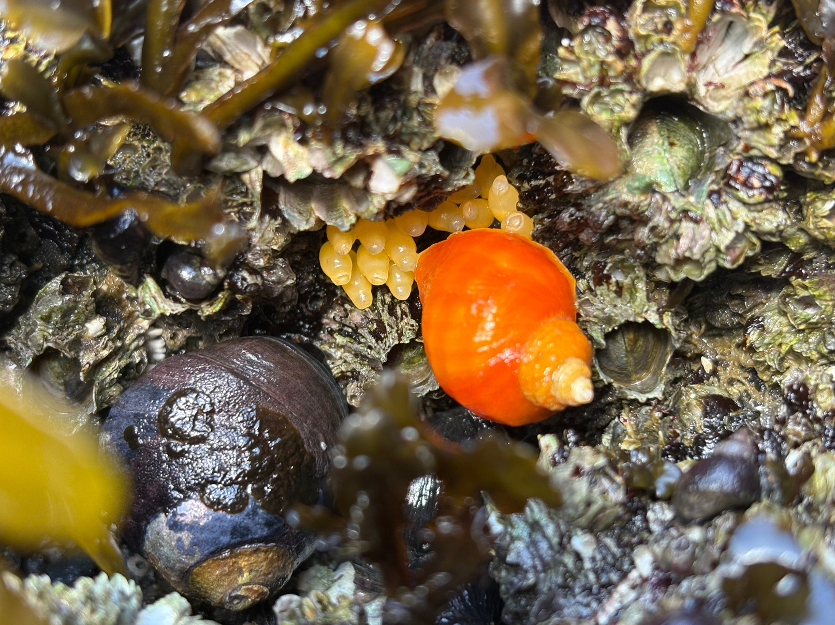
Research Objectives
Objective 1
Objective 2
Objective 3
Determine how lipid levels decrease in adult N. ostrina when exposed to varying temperatures, with and without access to food to replenish lipids lost?
Compare the lipid profile of juvenile and adult N. ostrina collected from two field sites that differ in environmental conditions and body size trends?
Assess if lipid profiles vary across life stages.

Slide 6
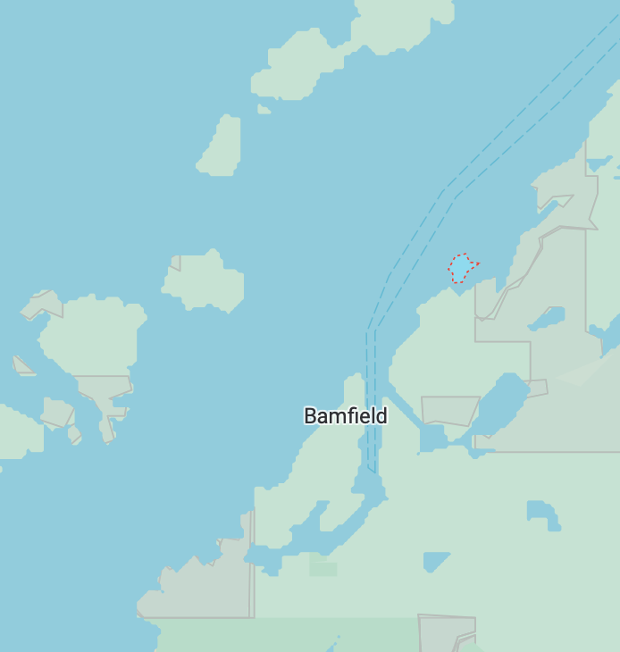

Animal Collection
  Collections took place over the months of May - July 2025 on the west coast of Vancouver Island in Bamfield, BC at the Bamfield Marine Science Center (BMSC).
Dixon Island
  Adults (~2 years), late juveniles (~6 months) and egg capsules were collected from both field sites
BMSC
  Egg capsules were hatched in the lab giving the early juvenile stage (24 hours old)
Prasiola Point
  Samples were than frozen and brought back to TRU for Lipid analysis

Slide 7
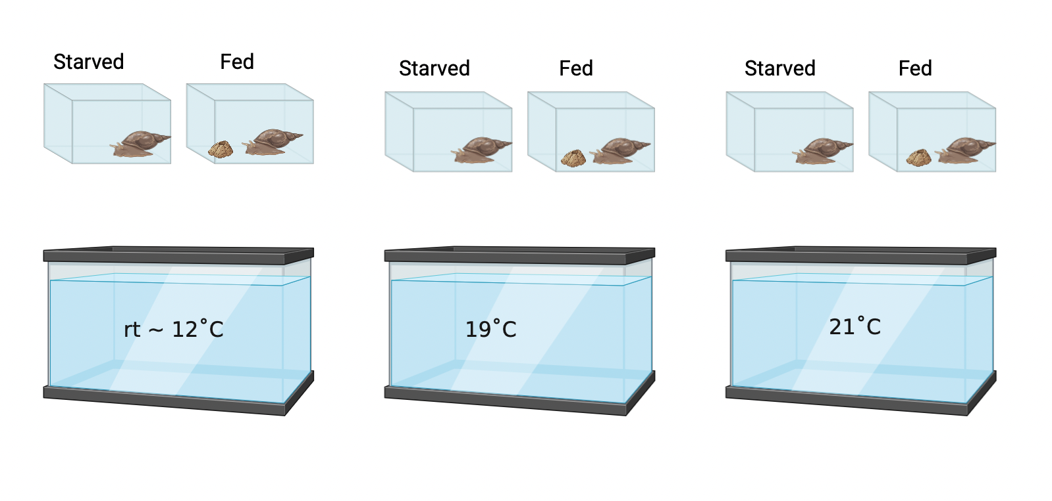

Experimental Setup Priority 1:
Temperature & Starvation
Experiment Duration of 19 days

Slide 8
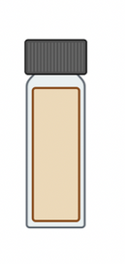
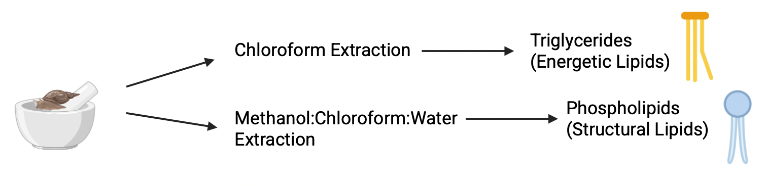

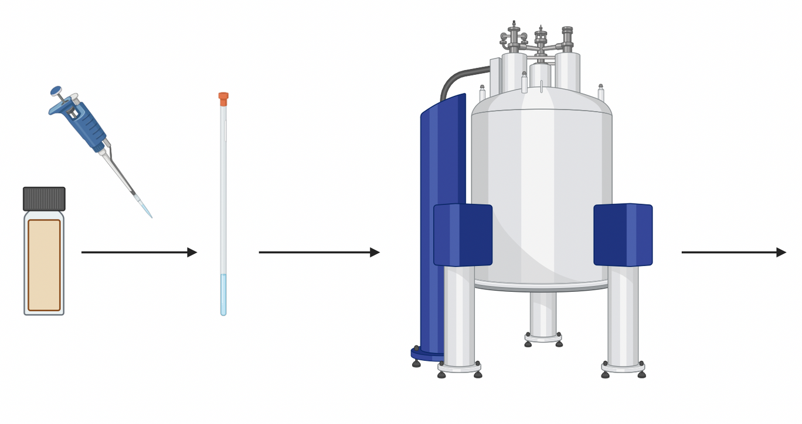
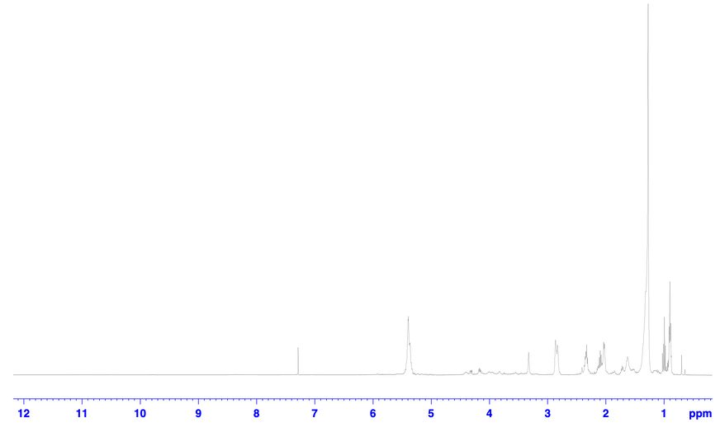
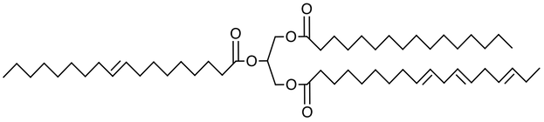
Lipid Analysis
Triglyceride
Spiked sample with internal standard of DME
Nuclear Magnetic Resonance (NMR) used to quantify lipid levels

Slide 9
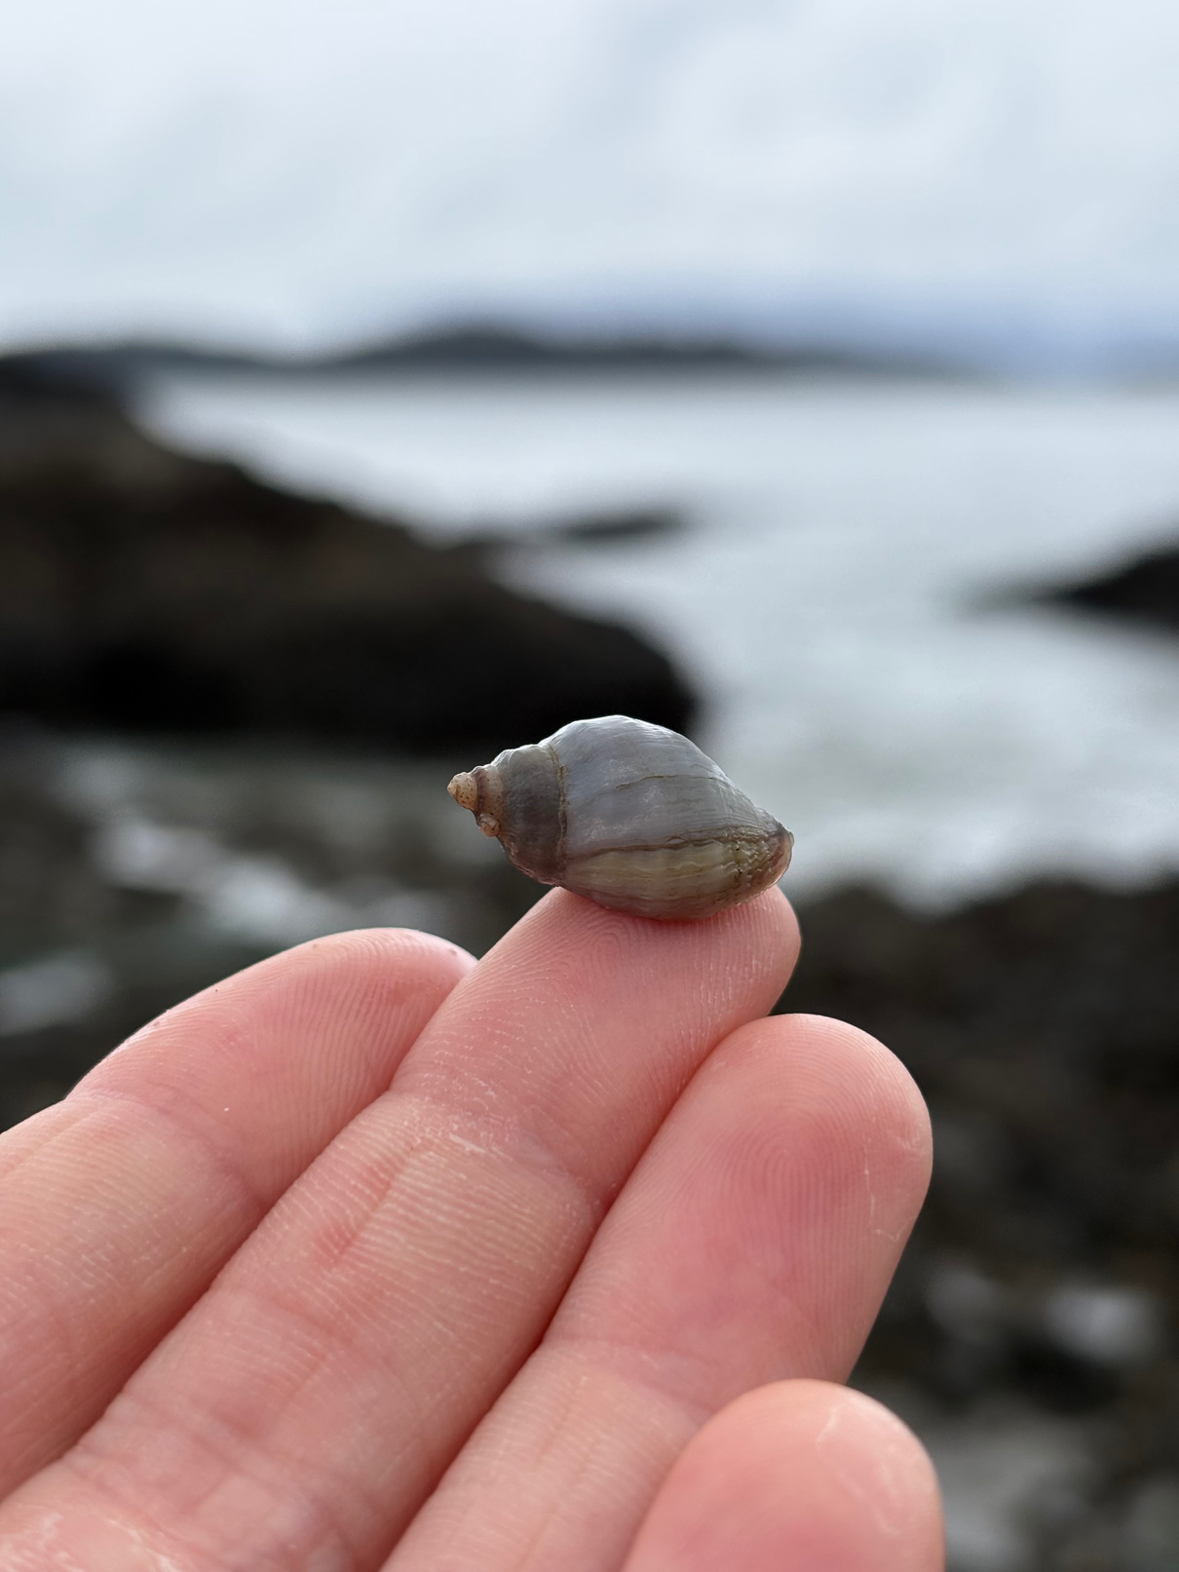


Conclusion
We hope to gain a greater understanding of energy reserves used by intertidal invertebrates and how they aid in survival.
Thank You!

Slide 10
References
  Mendt S, Gosselin L. 2022. Role of initial energy reserves on stress tolerance thresholds during the early benthic phase in intertidal invertebrates. Marine Ecology Progress Series. doi: https://doi.org/10.3354/meps13988.
  Vaughan-Wickihalder, M. British Columbia’s Intertidal Ecosystem. Spirit of the West Adventures. https://www.kayakingtours.com/2025/04/british-columbias-intertidal-ecosystem/ (accessed 2025-11-19).
  Gosselin, L.; Gallego, R.; Peters-Didier, J.; Sewell, M. Field Evidence of Interpopulation Variation in Oocyte Size of a Marine Invertebrate under Contrasting Temperature and Food Availability. Marine Ecology Progress Series 2019, 619, 69–84. https://doi.org/10.3354/meps12959.
  Dipesh Prema, Pilfold JL, Krauchi J, Church JS, Donkor KK, Cinel B. 2013. Rapid Determination of Total Conjugated Linoleic Acid Content in Select Canadian Cheeses by1H NMR Spectroscopy. Journal of Agricultural and Food Chemistry. 61(41):9915–9921. doi:https://doi.org/10.1021/jf402627q.
  ‌Prema D, Turner TD, Jensen J, Pilfold JL, Church JS, Donkor KK, Cinel B. 2015. Rapid determination of total conjugated linoleic acid concentrations in beef by 1 H NMR spectroscopy. Journal of Food Composition and Analysis. 41:54–57. doi:https://doi.org/10.1016/j.jfca.2014.12.017.
  Bligh EG, Dyer WJ. 1959. A RAPID METHOD OF TOTAL LIPID EXTRACTION AND PURIFICATION. Canadian Journal of Biochemistry and Physiology. 37(8):911–917. doi:https://doi.org/10.1139/o59-099.
‌

Slide 11
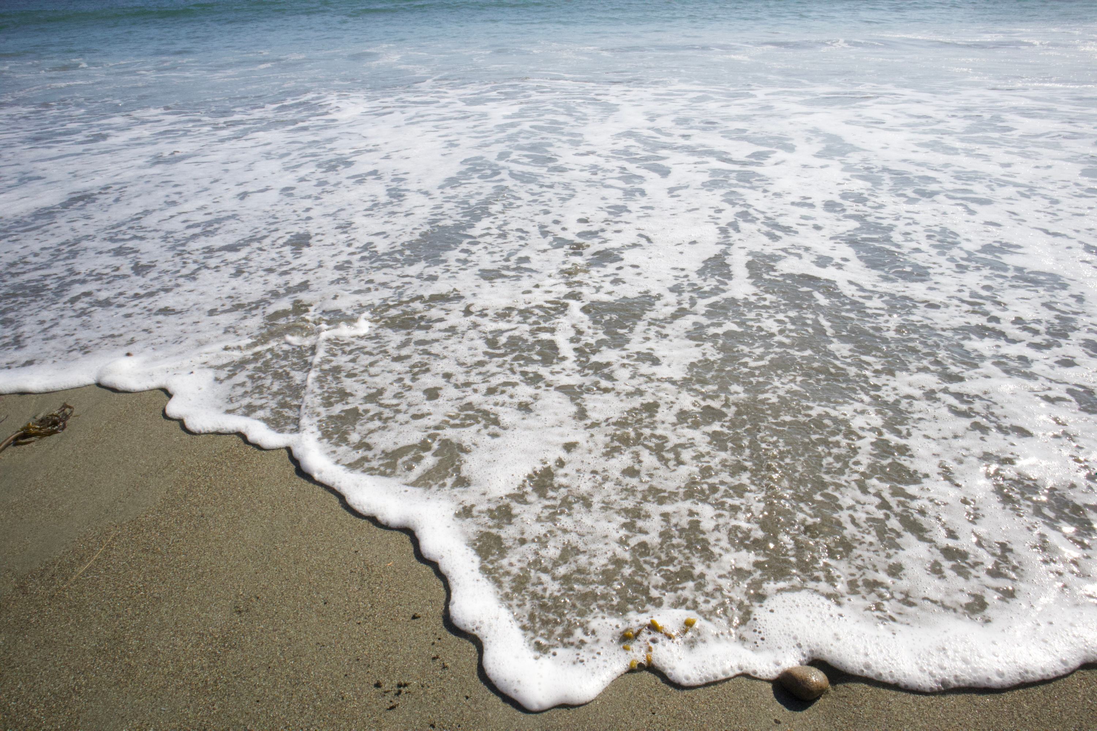
Questions?

